Slide 1

Analysis of Large Graphs: Link Analysis, PageRank
Note to other teachers and users of these slides: We would be delighted if you found this our material useful in giving your own lectures. Feel free to use these slides verbatim, or to modify them to fit your own needs. If you make use of a significant portion of these slides in your own lecture, please include this message, or a link to our web site: http://www.mmds.org
Mining of Massive Datasets
Jure Leskovec, Anand Rajaraman, Jeff Ullman Stanford University
http://www.mmds.org

Slide 2
New Topic: Graph Data!
High dim. data
Locality sensitive hashing
Clustering
Graph data
PageRank, SimRank
Community Detection
Infinite data
Filtering data streams
Web advertising
Dimensionality reduction
Spam Detection
Queries on streams
Machine learning
SVM
Decision Trees
Perceptron, kNN
Apps
Recommender systems
Association Rules
Duplicate document detection

Slide 3
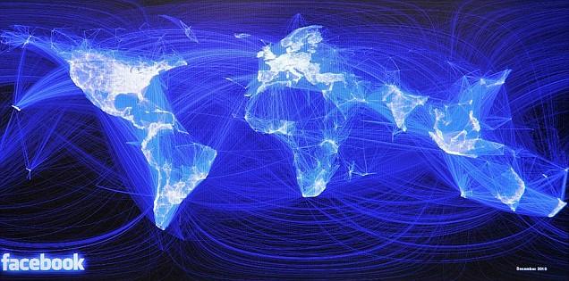
Graph Data: Social Networks
Facebook social graph
4-degrees of separation [Backstrom-Boldi-Rosa-Ugander-Vigna, 2011]

Slide 4
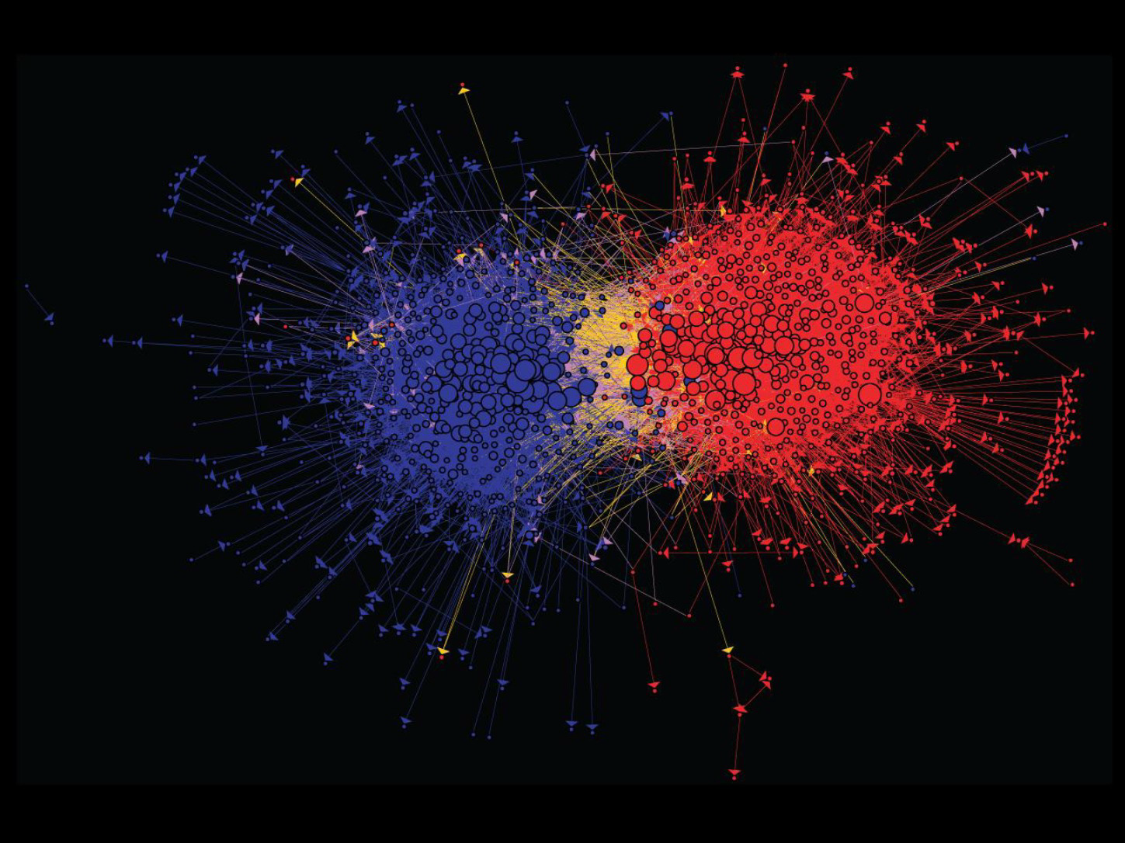
Graph Data: Media Networks
Connections between political blogs
Polarization of the network [Adamic-Glance, 2005]

Slide 5
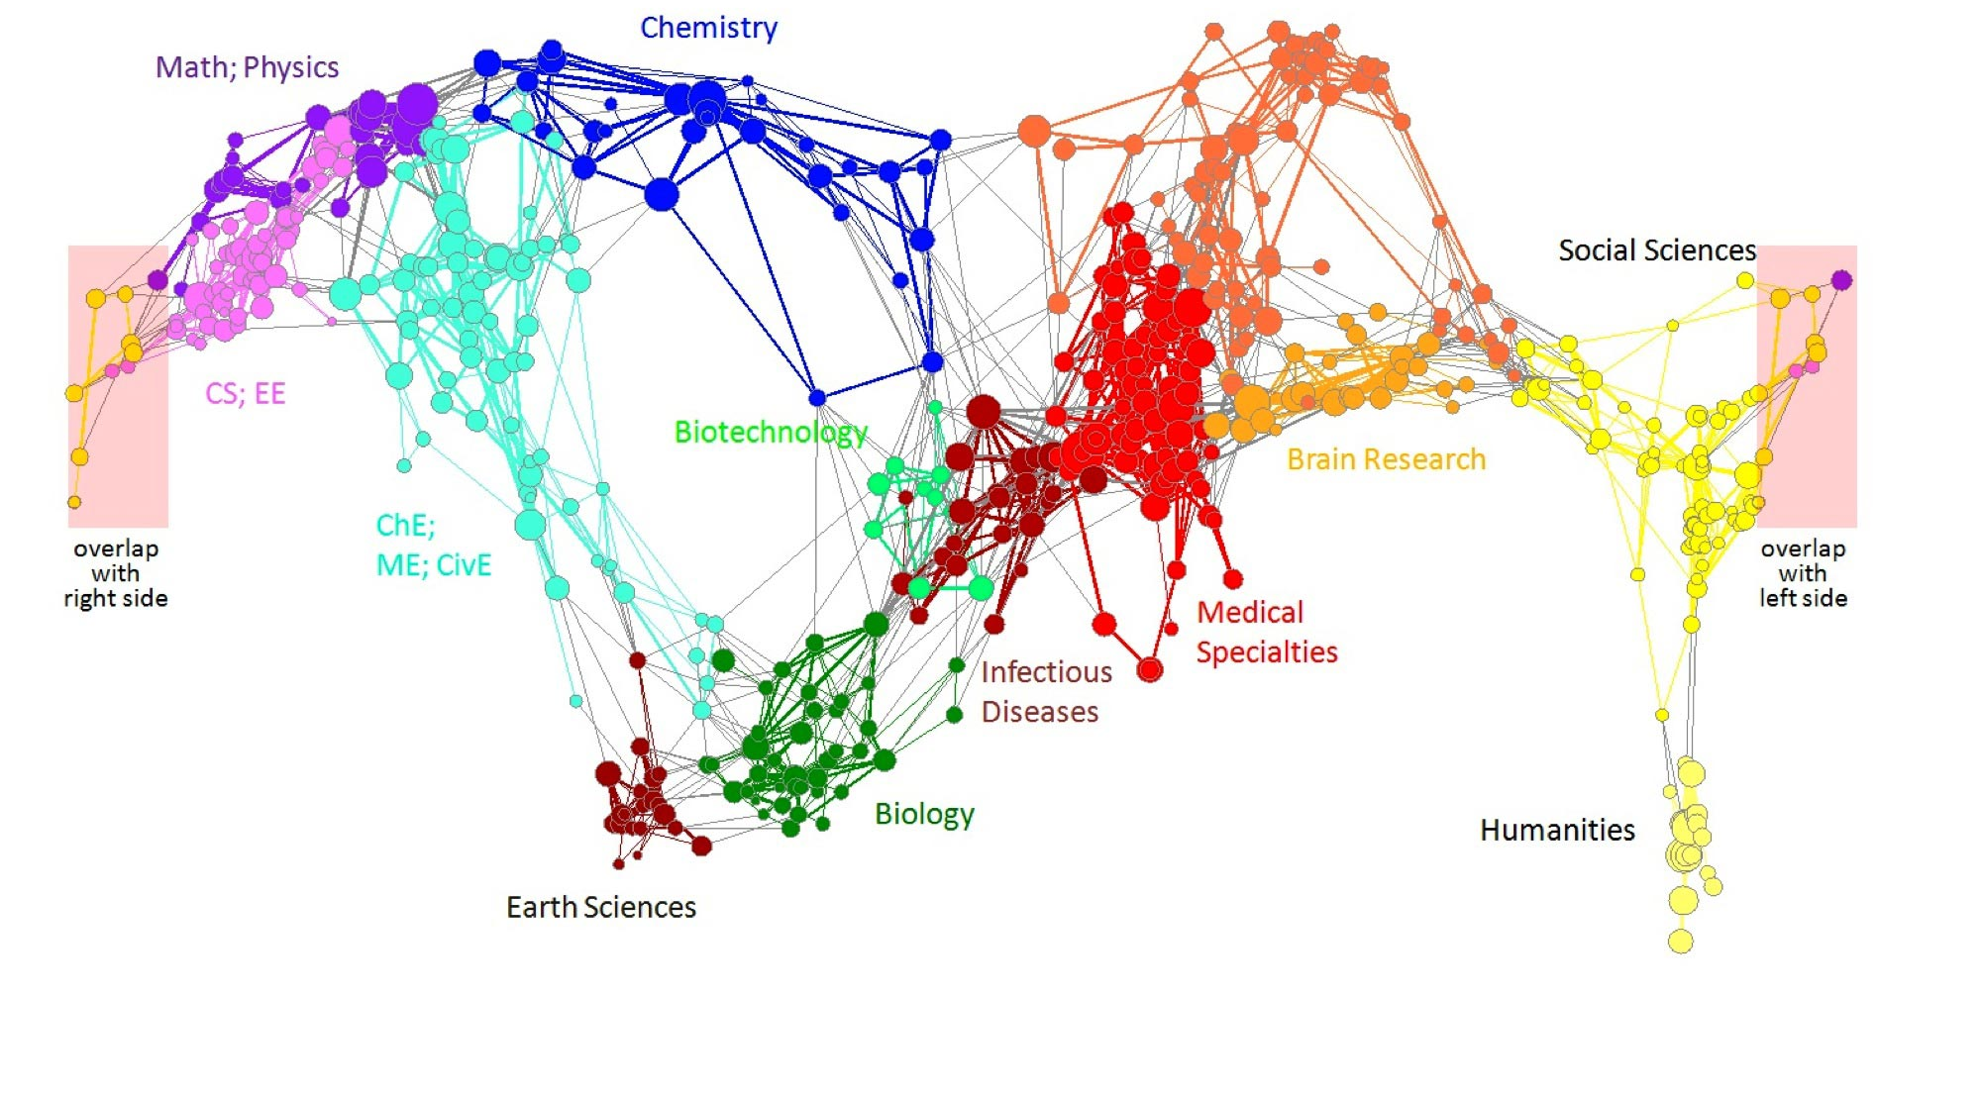
Graph Data: Information Nets
Citation networks and Maps of science
[Börner et al., 2012]

Slide 6
Graph Data: Communication Nets
domain2
domain1
router
domain3
Internet

Slide 7

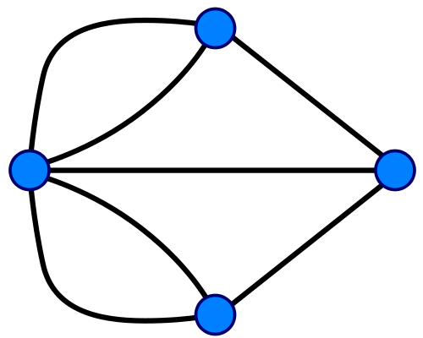
Graph Data: Technological Networks
Seven Bridges of Königsberg [Euler, 1735]
Return to the starting point by traveling each link of the graph once and only once.

Slide 8
Web as a Graph
Web as a directed graph:
Nodes: Webpages
Edges: Hyperlinks
I teach a class on Networks.
CS224W: Classes are in the Gates building
Computer Science Department at Stanford
Stanford University

Slide 9
Web as a Graph
Web as a directed graph:
Nodes: Webpages
Edges: Hyperlinks
I teach a class on Networks.
CS224W: Classes are in the Gates building
Computer Science Department at Stanford
Stanford University

Slide 10
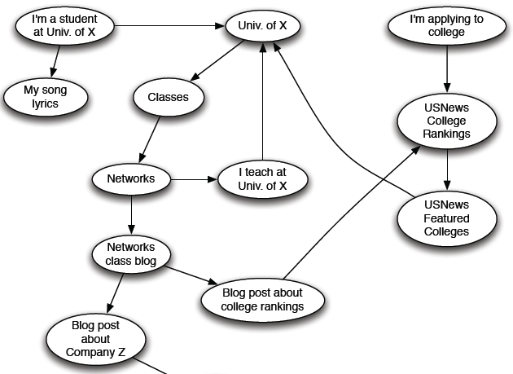
Web as a Directed Graph

Slide 11

Broad Question
How to organize the Web?
First try: Human curated Web directories
Yahoo, DMOZ, LookSmart
Second try: Web Search
Information Retrieval investigates: Find relevant docs in a small and trusted set
Newspaper articles, Patents, etc.
But: Web is huge, full of untrusted documents, random things, web spam, etc.

Slide 12
Web Search: 2 Challenges
2 challenges of web search:
(1) Web contains many sources of information Who to “trust”?
Trick: Trustworthy pages may point to each other!
(2) What is the “best” answer to query “newspaper”?
No single right answer
Trick: Pages that actually know about newspapers might all be pointing to many newspapers

Slide 13
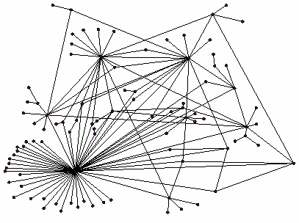
Ranking Nodes on the Graph
All web pages are not equally “important”
www.joe-schmoe.com vs. www.stanford.edu
There is large diversity in the web-graph node connectivity. Let’s rank the pages by the link structure!

Slide 14
Link Analysis Algorithms
We will cover the following Link Analysis approaches for computing importances of nodes in a graph:
Page Rank
Topic-Specific (Personalized) Page Rank
Web Spam Detection Algorithms

Slide 15
PageRank: The “Flow” Formulation

Slide 16
Links as Votes
Idea: Links as votes
Page is more important if it has more links
In-coming links? Out-going links?
Think of in-links as votes:
www.stanford.edu has 23,400 in-links
www.joe-schmoe.com has 1 in-link
Are all in-links are equal?
Links from important pages count more
Recursive question!

Slide 17
Example: PageRank Scores
B
38.4
C
34.3
A
3.3
D
3.9
E
8.1
F
3.9
1.6
1.6
1.6
1.6
1.6

Slide 18
Simple Recursive Formulation
Each link’s vote is proportional to the importance of its source page
If page j with importance r_{j} has n out-links, each link gets r_{j} / n votes
Page j’s own importance is the sum of the votes on its in-links
i
k
r_{i}/3
r_{k}/4
j
r_{j}/3
r_{j} = r_{i}/3+r_{k}/4
r_{j}/3
r_{j}/3

Slide 19
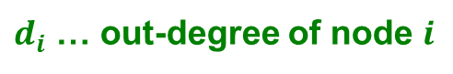
PageRank: The “Flow” Model
A “vote” from an important page is worth more
A page is important if it is pointed to by other important pages
Define a “rank” r_{j} for page j
The web in 1839
y/2
y
a/2
y/2
m
a
m
a/2
“Flow” equations:
r_{y} = r_{y} /2 + r_{a} /2
r_{a} = r_{y} /2 + r_{m}
r_{m} = r_{a} /2
$d_{i}$ … out-degree of node $i$

Slide 20
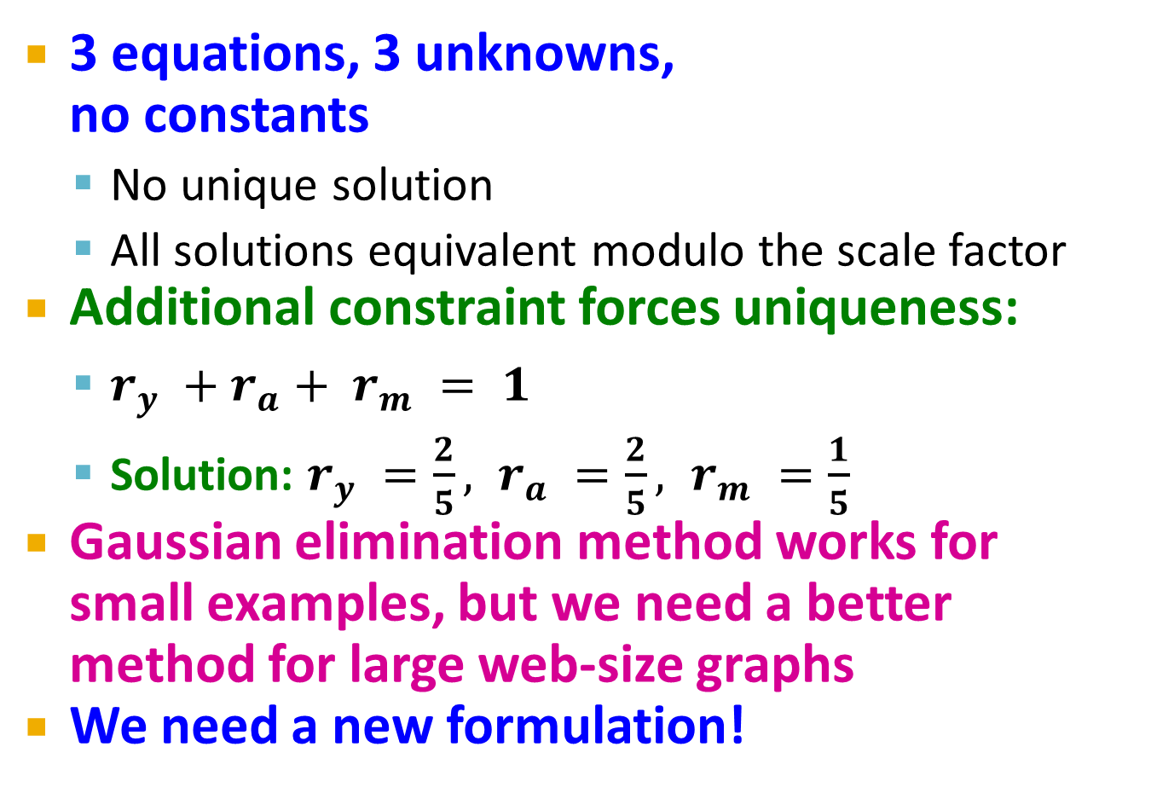
Solving the Flow Equations
Flow equations:
3 equations, 3 unknowns, no constants
No unique solution
All solutions equivalent modulo the scale factor
Additional constraint forces uniqueness:
$r_{y} +r_{a}+ r_{m} = 1$
Solution: $r_{y} =\frac{2}{5}, r_{a} =\frac{2}{5}, r_{m} =\frac{1}{5}$
Gaussian elimination method works for small examples, but we need a better method for large web-size graphs
We need a new formulation!
r_{y} = r_{y} /2 + r_{a} /2
r_{a} = r_{y} /2 + r_{m}
r_{m} = r_{a} /2

Slide 21
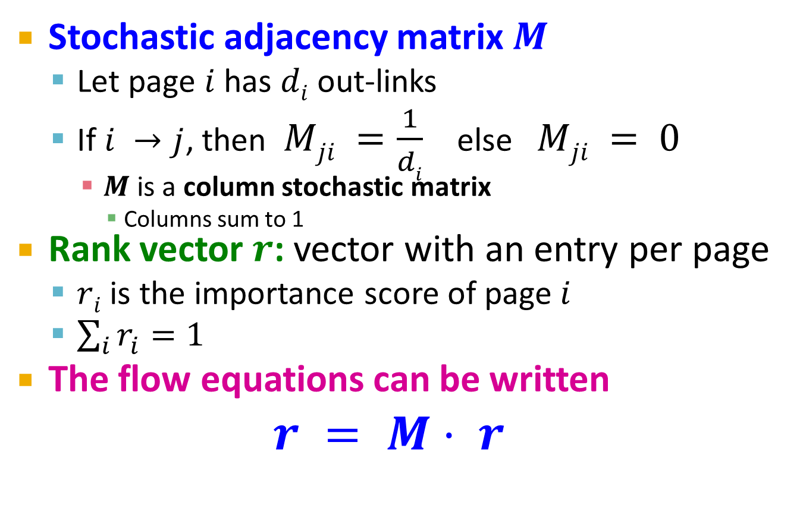
PageRank: Matrix Formulation
Stochastic adjacency matrix $M$
Let page $i$ has $di$ out-links
If $i →j$, then $Mji =\frac{1}{di}$ else $Mji = 0$
$M$ is a column stochastic matrix
Columns sum to 1
Rank vector $r$: vector with an entry per page
$ri$ is the importance score of page $i$
$\sum_{i}{r_{i}^{}=1}$
The flow equations can be written $r = M⋅ r$

Slide 22
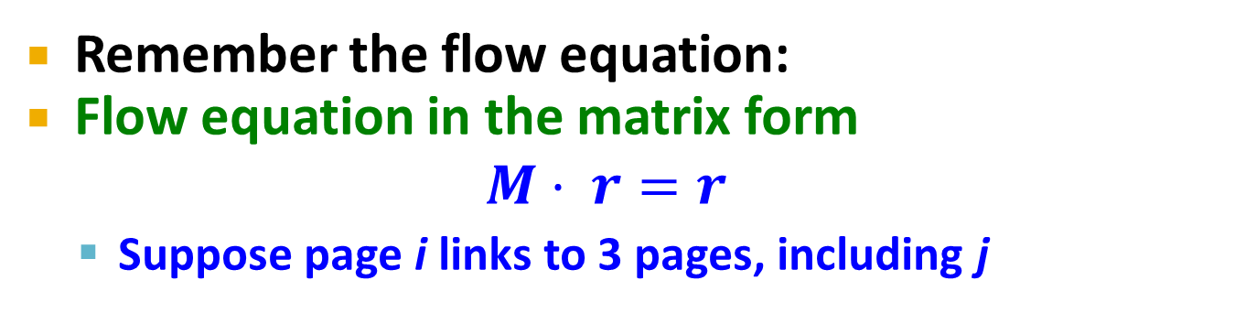
Example
Remember the flow equation:
Flow equation in the matrix form
$$M⋅ r=r$$
Suppose page i links to 3 pages, including j
i
j
r_{j}
.
=
r_{i}
1/3
M
.
r
=
r

Slide 23
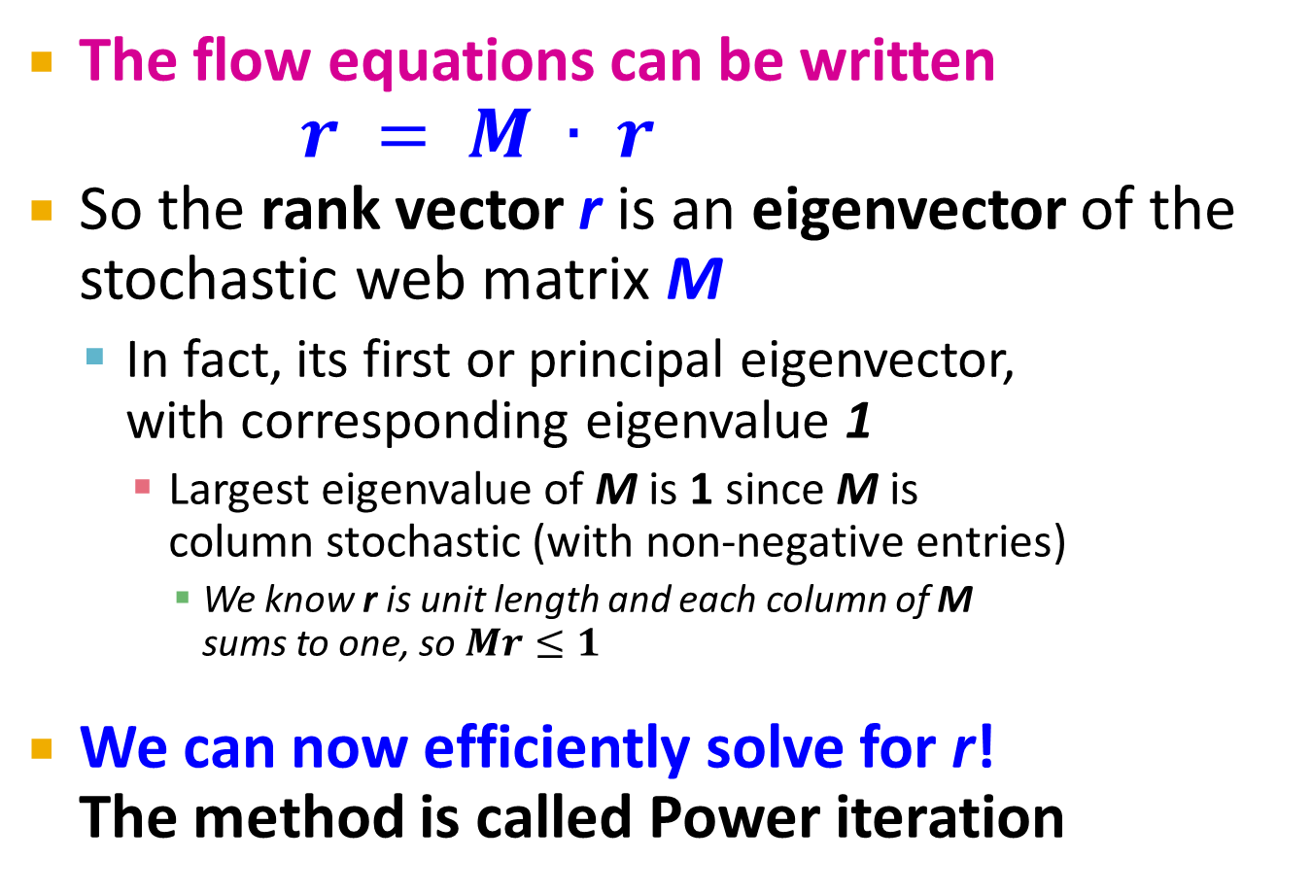
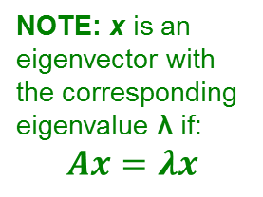
Eigenvector Formulation
The flow equations can be written $r = M ∙ r$
So the rank vector r is an eigenvector of the stochastic web matrix M
In fact, its first or principal eigenvector, with corresponding eigenvalue 1
Largest eigenvalue of M is 1 since M is column stochastic (with non-negative entries)
We know r is unit length and each column of M sums to one, so $Mr≤1$
We can now efficiently solve for r! The method is called Power iteration
NOTE: x is an eigenvector with the corresponding eigenvalue λ if: $$Ax=λx$$

Slide 24
Example: Flow Equations & M
 | y | a | m
y | ½ | ½ | 0
a | ½ | 0 | 1
m | 0 | ½ | 0
y
a
m
r = M∙r
r_{y} = r_{y} /2 + r_{a} /2
r_{a} = r_{y} /2 + r_{m}
r_{m} = r_{a} /2
y ½ ½ 0 y
a = ½ 0 1 a
m 0 ½ 0 m

Slide 25
Power Iteration Method
Given a web graph with n nodes, where the nodes are pages and edges are hyperlinks
Power iteration: a simple iterative scheme
Suppose there are N web pages
Initialize: r⁽⁰⁾ = [1/N,….,1/N]^{T}
Iterate: r^{(t+1)} = M ∙ r^{(t)}
Stop when |r^{(t+1)} – r^{(t)}|₁ < ε
d_{i} …. out-degree of node i
|x|₁ = ∑_{1≤i≤N}|x_{i}| is the L1 norm
Can use any other vector norm, e.g., Euclidean

Slide 26
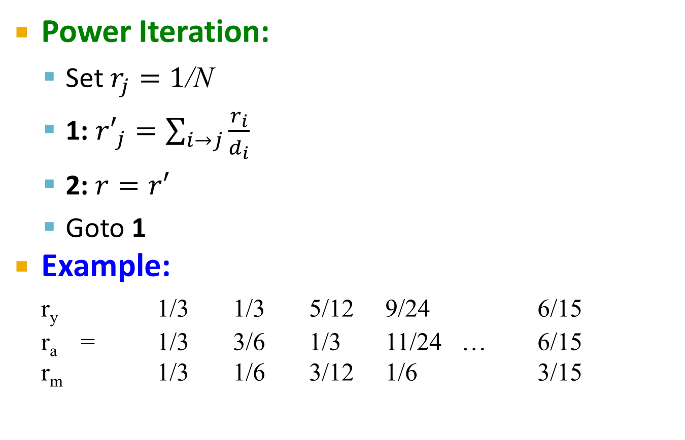
PageRank: How to solve?
Power Iteration:
Set $r_{j}=1$/N
1: ${r′}_{j}=\sum_{i→j}{\frac{r_{i}}{d_{i}}}$
2:$r=r′$
Goto 1
Example:
r_{y} 1/3 1/3 5/12 9/24 6/15
r_{a} = 1/3 3/6 1/3 11/24 … 6/15
r_{m} 1/3 1/6 3/12 1/6 3/15
y
 | y | a | m
y | ½ | ½ | 0
a | ½ | 0 | 1
m | 0 | ½ | 0
a
m
r_{y} = r_{y} /2 + r_{a} /2
r_{a} = r_{y} /2 + r_{m}
r_{m} = r_{a} /2
Iteration 0, 1, 2, …

Slide 27
PageRank: How to solve?
Power Iteration:
Set $r_{j}=1$/N
1: ${r′}_{j}=\sum_{i→j}{\frac{r_{i}}{d_{i}}}$
2:$r=r′$
Goto 1
Example:
r_{y} 1/3 1/3 5/12 9/24 6/15
r_{a} = 1/3 3/6 1/3 11/24 … 6/15
r_{m} 1/3 1/6 3/12 1/6 3/15
y
 | y | a | m
y | ½ | ½ | 0
a | ½ | 0 | 1
m | 0 | ½ | 0
a
m
r_{y} = r_{y} /2 + r_{a} /2
r_{a} = r_{y} /2 + r_{m}
r_{m} = r_{a} /2
Iteration 0, 1, 2, …

Slide 28
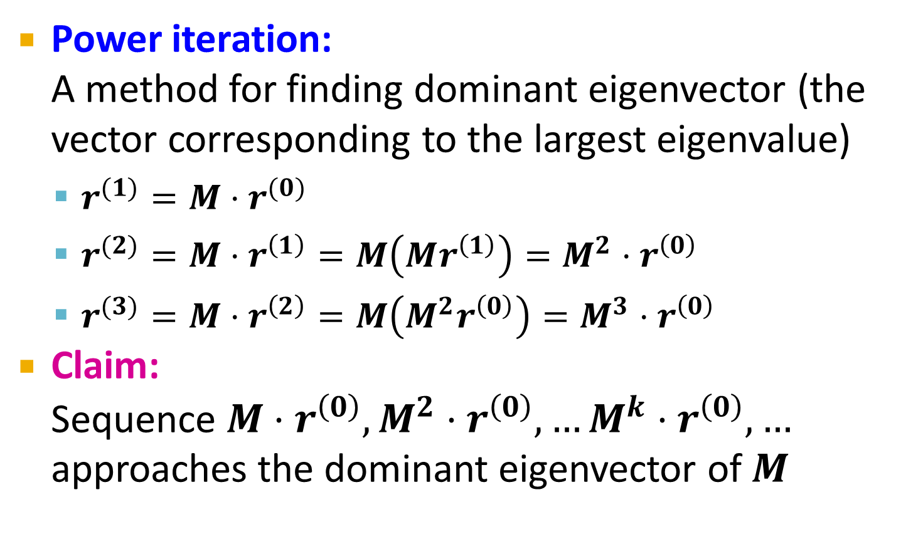
Why Power Iteration works? (1)
Details!
Power iteration: A method for finding dominant eigenvector (the vector corresponding to the largest eigenvalue)
$r^{(1)}=M⋅r^{(0)}$
$r^{(2)}=M⋅r^{\left(1\right)}=M\left(Mr^{\left(1\right)}\right)=M^{2}⋅r^{\left(0\right)}$
$r^{(3)}=M⋅r^{\left(2\right)}=M\left(M^{2}r^{\left(0\right)}\right)=M^{3}⋅r^{\left(0\right)}$
Claim: Sequence $M⋅r^{\left(0\right)},M^{2}⋅r^{\left(0\right)},…M^{k}⋅r^{\left(0\right)},…$ approaches the dominant eigenvector of $M$

Slide 29
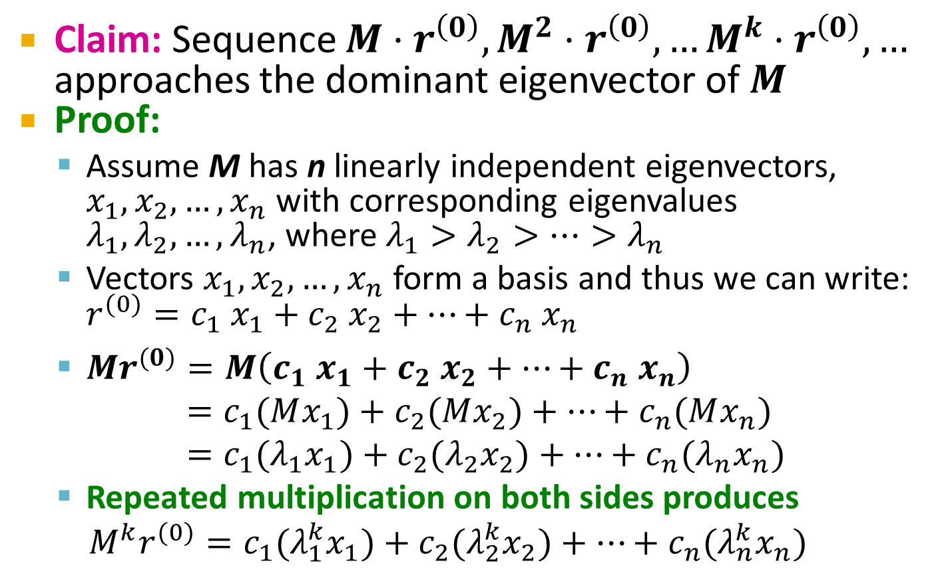
Why Power Iteration works? (2)
Details!
Claim: Sequence $M⋅r^{\left(0\right)},M^{2}⋅r^{\left(0\right)},…M^{k}⋅r^{\left(0\right)},…$ approaches the dominant eigenvector of $M$
Proof:
Assume M has n linearly independent eigenvectors, $x_{1}, x_{2}, …, x_{n}$ with corresponding eigenvalues $λ_{1},λ_{2}, …,λ_{n}$, where $λ_{1}>λ_{2}>…>λ_{n}$
Vectors $x_{1}, x_{2}, …, x_{n}$ form a basis and thus we can write: ${r^{(0)}=c_{1} x}_{1}+c_{2} x_{2}+…+c_{n} x_{n}$
$Mr^{(0)}=M\left(c_{1} x_{1}+c_{2} x_{2}+…+c_{n} x_{n}\right)$
$=c_{1}(Mx_{1})+c_{2}(Mx_{2})+…+c_{n}(Mx_{n})$
$=c_{1}(λ_{1}x_{1})+c_{2}(λ_{2}x_{2})+…+c_{n}(λ_{n}x_{n})$
Repeated multiplication on both sides produces
$M^{k}r^{(0)}=c_{1}(λ_{1}^{k}x_{1})+c_{2}(λ_{2}^{k}x_{2})+…+c_{n}(λ_{n}^{k}x_{n})$

Slide 30
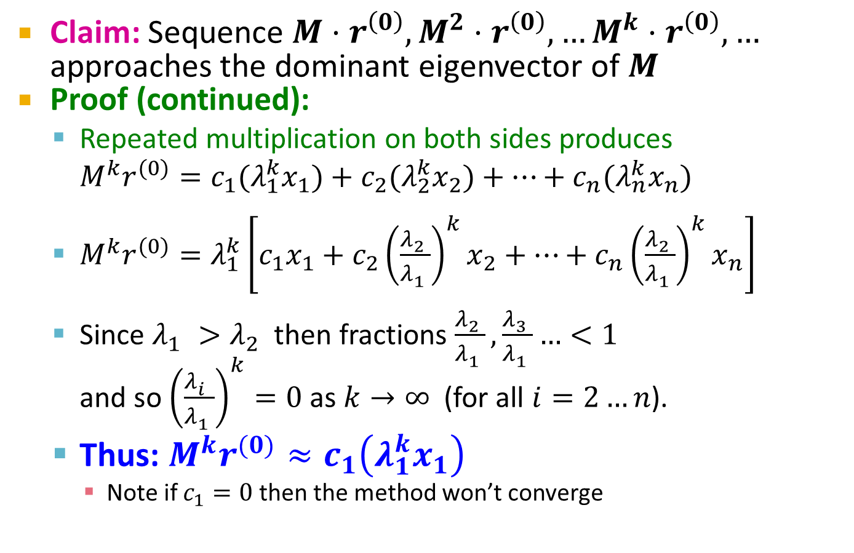
Why Power Iteration works? (3)
Details!
Claim: Sequence $M⋅r^{\left(0\right)},M^{2}⋅r^{\left(0\right)},…M^{k}⋅r^{\left(0\right)},…$ approaches the dominant eigenvector of $M$
Proof (continued):
Repeated multiplication on both sides produces
$M^{k}r^{(0)}=c_{1}(λ_{1}^{k}x_{1})+c_{2}(λ_{2}^{k}x_{2})+…+c_{n}(λ_{n}^{k}x_{n})$
$M^{k}r^{(0)}=λ_{1}^{k}\left[c_{1}x_{1}+c_{2}{\left(\frac{λ_{2}^{}}{λ_{1}^{}}\right)}^{k}x_{2}+…+c_{n}{\left(\frac{λ_{2}^{}}{λ_{1}^{}}\right)}^{k}x_{n}\right]$
Since $λ_{1}^{}>λ_{2}^{}$ then fractions $\frac{λ_{2}^{}}{λ_{1}^{}},\frac{λ_{3}^{}}{λ_{1}^{}}…<1$ and so ${\left(\frac{λ_{i}^{}}{λ_{1}^{}}\right)}^{k}=0$ as $k→∞$ (for all $i=2…n$).
Thus: $M^{k}r^{(0)}≈c_{1}\left(λ_{1}^{k}x_{1}\right)$
Note if $c_{1}=0$ then the method won’t converge

Slide 31
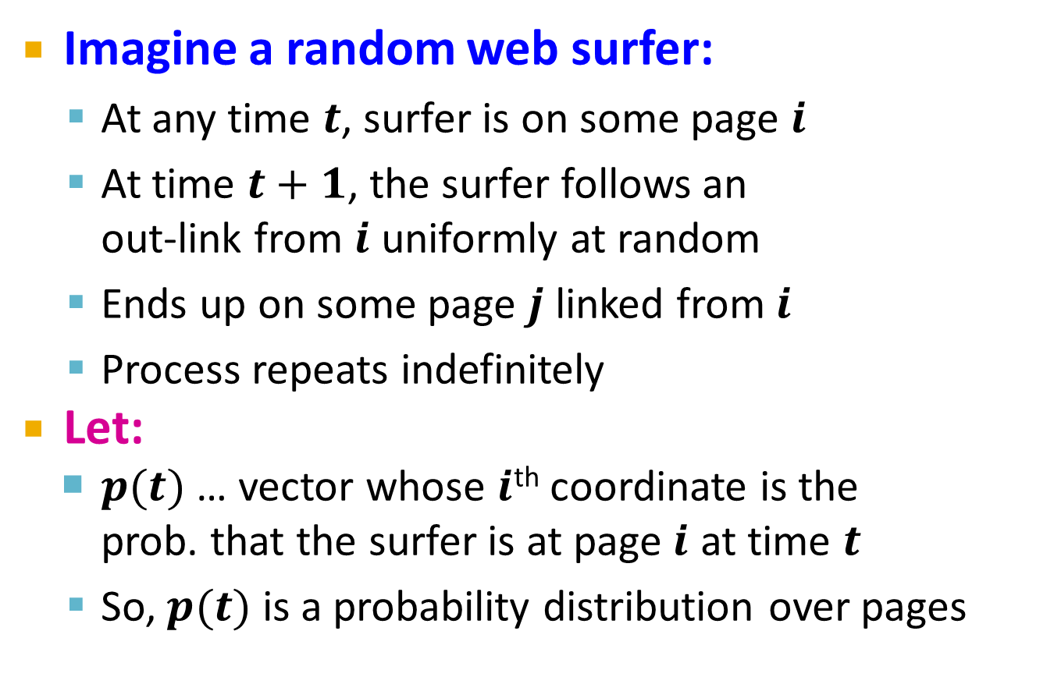
Random Walk Interpretation
Imagine a random web surfer:
At any time $t$, surfer is on some page $i$
At time $t+1$, the surfer follows an out-link from $i$ uniformly at random
Ends up on some page $j$ linked from $i$
Process repeats indefinitely
Let:
$p(t)$ … vector whose $i$^{th} coordinate is the prob. that the surfer is at page $i$ at time $t$
So, $p(t)$ is a probability distribution over pages
i₁
i₂
i₃
j

Slide 32
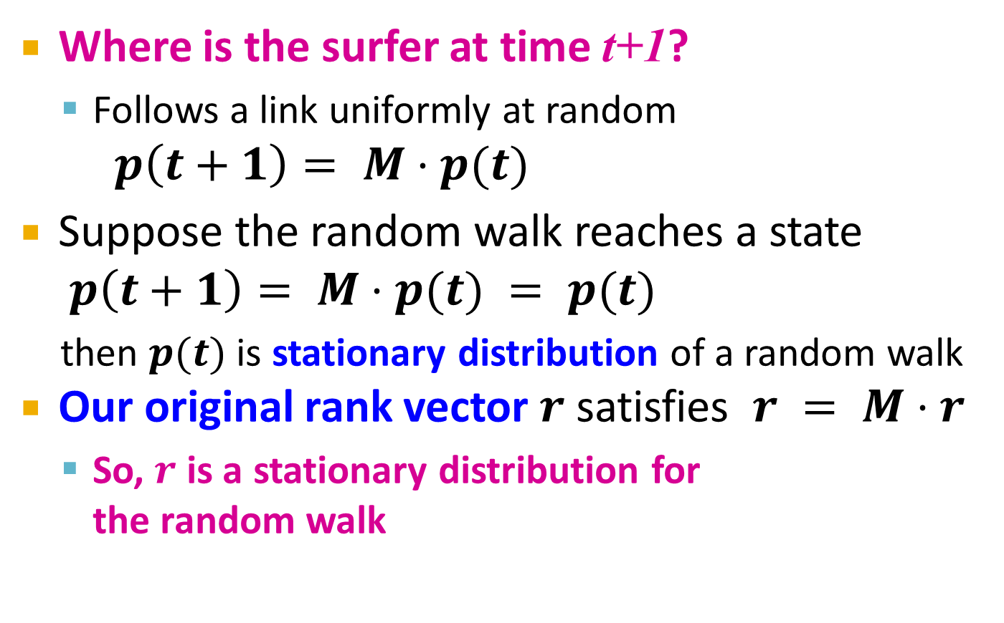
The Stationary Distribution
i₁
i₂
i₃
Where is the surfer at time t+1?
Follows a link uniformly at random
$p\left(t+1\right)= M⋅p(t)$
Suppose the random walk reaches a state $p\left(t+1\right)= M⋅p(t) = p(t)$
then $p(t)$ is stationary distribution of a random walk
Our original rank vector $r$ satisfies $r = M⋅r$
So, $r$ is a stationary distribution for the random walk
j

Slide 33
Existence and Uniqueness
A central result from the theory of random walks (a.k.a. Markov processes):
For graphs that satisfy certain conditions, the stationary distribution is unique and eventually will be reached no matter what the initial probability distribution at time t = 0

Slide 34
PageRank: The Google Formulation

Slide 35
PageRank: Three Questions
Does this converge?
Does it converge to what we want?
Are results reasonable?
or
equivalently

Slide 36
Does this converge?
Example:
r_{a} 1 0 1 0
r_{b} 0 1 0 1
a
b
=
Iteration 0, 1, 2, …

Slide 37
Does it converge to what we want?
Example:
r_{a} 1 0 0 0
r_{b} 0 1 0 0
a
b
=
Iteration 0, 1, 2, …

Slide 38
PageRank: Problems
Dead end
2 problems:
(1) Some pages are dead ends (have no out-links)
Random walk has “nowhere” to go to
Such pages cause importance to “leak out”
(2) Spider traps: (all out-links are within the group)
Random walked gets “stuck” in a trap
And eventually spider traps absorb all importance
Spider trap

Slide 39
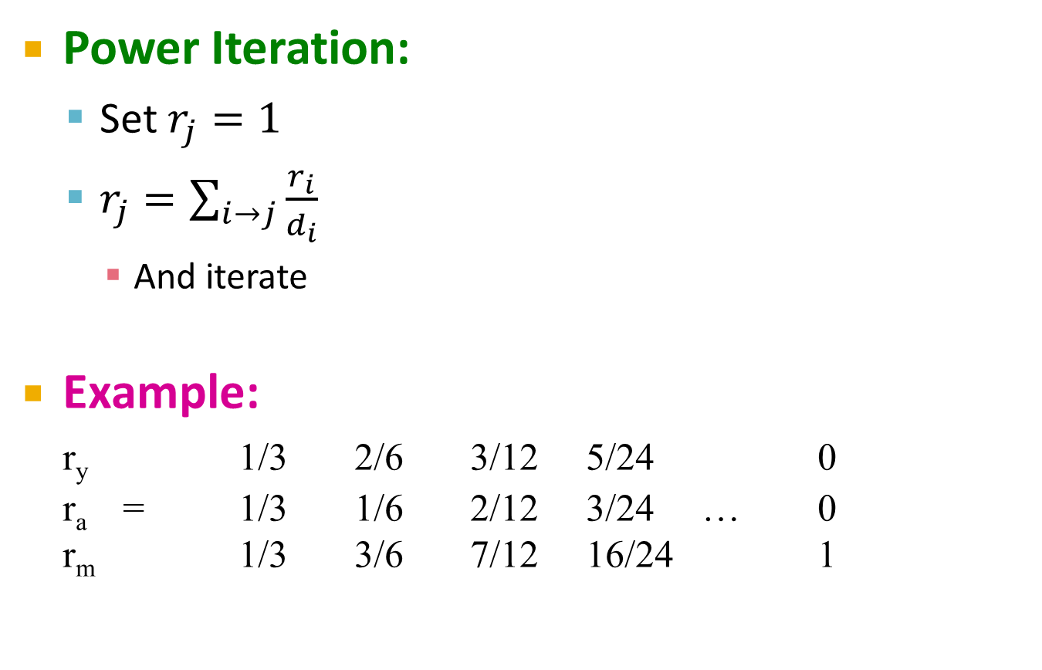
Problem: Spider Traps
Power Iteration:
Set $r_{j}=1$
$r_{j}=\sum_{i→j}{\frac{r_{i}}{d_{i}}}$
And iterate
Example:
r_{y} 1/3 2/6 3/12 5/24 0
r_{a} = 1/3 1/6 2/12 3/24 … 0
r_{m} 1/3 3/6 7/12 16/24 1
y
 | y | a | m
y | ½ | ½ | 0
a | ½ | 0 | 0
m | 0 | ½ | 1
a
m
m is a spider trap
r_{y} = r_{y} /2 + r_{a} /2
r_{a} = r_{y} /2
r_{m} = r_{a} /2 + r_{m}
Iteration 0, 1, 2, …
All the PageRank score gets “trapped” in node m.

Slide 40
Solution: Teleports!
The Google solution for spider traps: At each time step, the random surfer has two options
With prob. β, follow a link at random
With prob. 1-β, jump to some random page
Common values for β are in the range 0.8 to 0.9
Surfer will teleport out of spider trap within a few time steps
y
y
a
m
a
m

Slide 41

Problem: Dead Ends
Power Iteration:
Set $r_{j}=1$
$r_{j}=\sum_{i→j}{\frac{r_{i}}{d_{i}}}$
And iterate
Example:
r_{y} 1/3 2/6 3/12 5/24 0
r_{a} = 1/3 1/6 2/12 3/24 … 0
r_{m} 1/3 1/6 1/12 2/24 0
y
 | y | a | m
y | ½ | ½ | 0
a | ½ | 0 | 0
m | 0 | ½ | 0
a
m
r_{y} = r_{y} /2 + r_{a} /2
r_{a} = r_{y} /2
r_{m} = r_{a} /2
Iteration 0, 1, 2, …
Here the PageRank “leaks” out since the matrix is not stochastic.

Slide 42
Solution: Always Teleport!
Teleports: Follow random teleport links with probability 1.0 from dead-ends
Adjust matrix accordingly
y
y
a
m
a
m
 | y | a | m
y | ½ | ½ | 0
a | ½ | 0 | 0
m | 0 | ½ | 0
 | y | a | m
y | ½ | ½ | ⅓
a | ½ | 0 | ⅓
m | 0 | ½ | ⅓

Slide 43
Why Teleports Solve the Problem?
Why are dead-ends and spider traps a problem and why do teleports solve the problem?
Spider-traps are not a problem, but with traps PageRank scores are not what we want
Solution: Never get stuck in a spider trap by teleporting out of it in a finite number of steps
Dead-ends are a problem
The matrix is not column stochastic so our initial assumptions are not met
Solution: Make matrix column stochastic by always teleporting when there is nowhere else to go

Slide 44
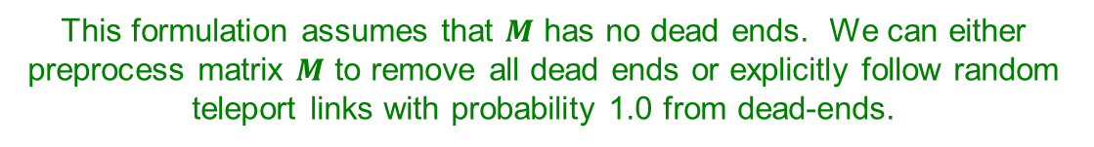
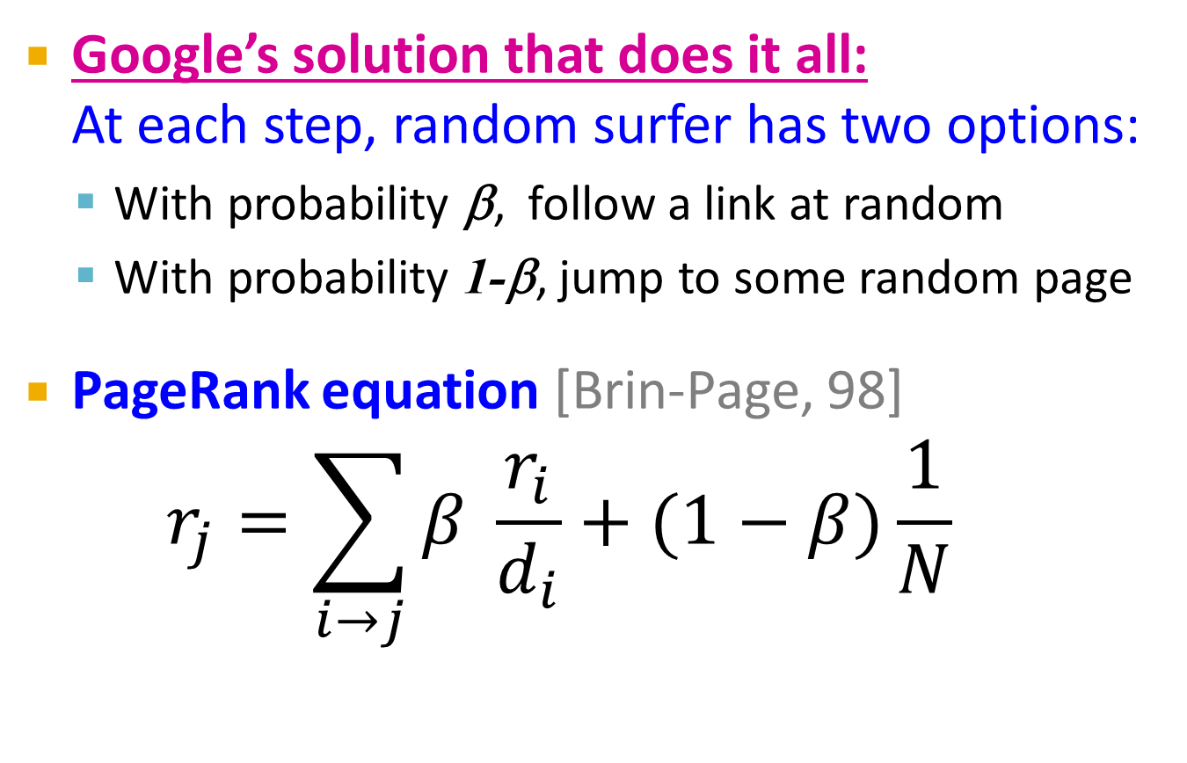
Solution: Random Teleports
Google’s solution that does it all: At each step, random surfer has two options:
With probability β, follow a link at random
With probability 1-β, jump to some random page
PageRank equation [Brin-Page, 98] $r_{j}=\sum_{i→j}{β \frac{r_{i}}{d_{i}}}+(1−β)\frac{1}{N}$
d_{i} … out-degree of node i
This formulation assumes that $M$ has no dead ends. We can either preprocess matrix $M$ to remove all dead ends or explicitly follow random teleport links with probability 1.0 from dead-ends.

Slide 45
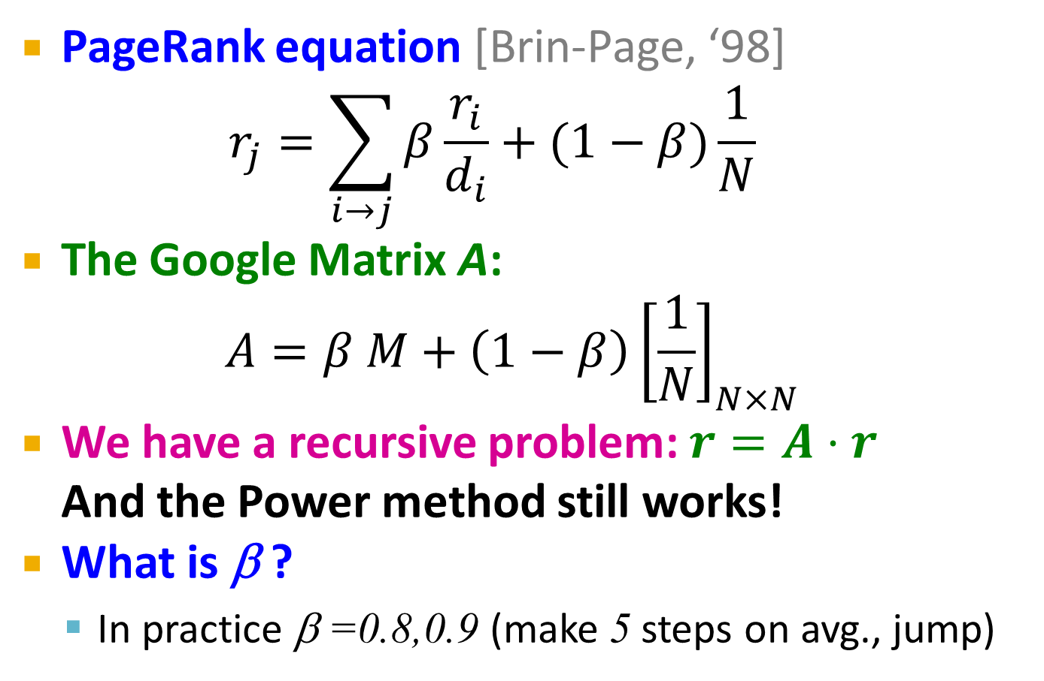
The Google Matrix
PageRank equation [Brin-Page, ‘98] $r_{j}=\sum_{i→j}{β\frac{r_{i}}{d_{i}}}+(1−β)\frac{1}{N}$
The Google Matrix A:
$$A=β M+\left(1−β\right){\left[\frac{1}{N}\right]}_{N×N}$$
We have a recursive problem: $r=A⋅r$ And the Power method still works!
What is β ?
In practice β =0.8,0.9 (make 5 steps on avg., jump)
[1/N]_{NxN}…N by N matrix where all entries are 1/N

Slide 46
Random Teleports (β = 0.8)
M
[1/N]_{NxN}
7/15
y
1/2 1/2 0
1/2 0 0
0 1/2 1
1/3 1/3 1/3
1/3 1/3 1/3
1/3 1/3 1/3
0.8
+ 0.2
7/15
1/15
7/15
1/15
y 7/15 7/15 1/15
a 7/15 1/15 1/15
m 1/15 7/15 13/15
13/15
a
7/15
m
1/15
1/15
A
y
a =
m
1/3
1/3
1/3
0.33
0.20
0.46
0.24
0.20
0.52
0.26
0.18
0.56
7/33
5/33
21/33
. . .

Slide 47
How do we actually compute the PageRank?

Slide 48
Computing Page Rank
Key step is matrix-vector multiplication
r^{new} = A ∙ r^{old}
Easy if we have enough main memory to hold A, r^{old}, r^{new}
Say N = 1 billion pages
We need 4 bytes for each entry (say)
2 billion entries for vectors, approx 8GB
Matrix A has N² entries
10¹⁸ is a large number!
A = β∙M + (1-β) [1/N]_{NxN}
½ ½ 0
½ 0 0
0 ½ 1
1/3 1/3 1/3
1/3 1/3 1/3
1/3 1/3 1/3
A =
0.8
+0.2
7/15 7/15 1/15
7/15 1/15 1/15
1/15 7/15 13/15
=

Slide 49
Matrix Formulation
Suppose there are N pages
Consider page i, with d_{i} out-links
We have M_{ji} = 1/|d_{i}| when i → j and M_{ji} = 0 otherwise
The random teleport is equivalent to:
Adding a teleport link from i to every other page and setting transition probability to (1-β)/N
Reducing the probability of following each out-link from 1/|d_{i}| to β/|d_{i}|
Equivalent: Tax each page a fraction (1-β) of its score and redistribute evenly

Slide 50
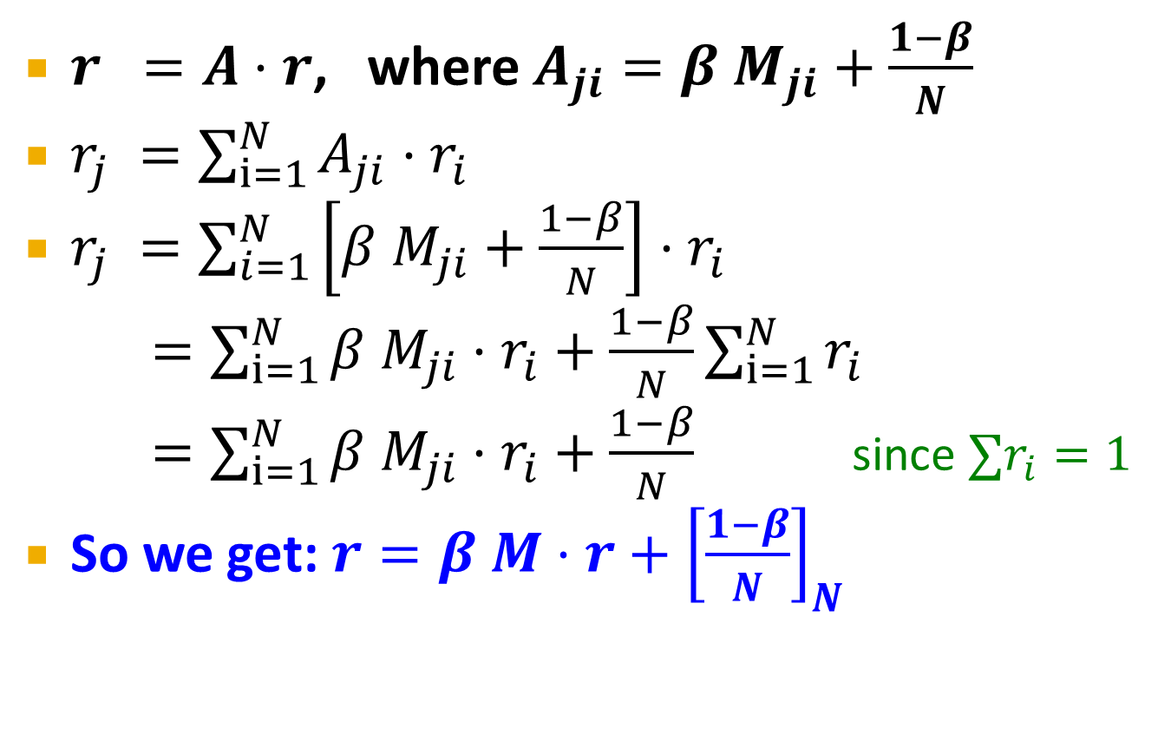
Rearranging the Equation
$r =A⋅r$, where $A_{ji}=β{ M}_{ji}+\frac{1−β}{N}$
$r_{j} =\sum_{i=1}^{N}{A_{ji}⋅r_{i}}$
$r_{j} =\sum_{i=1}^{N}{\left[β{ M}_{ji}+\frac{1−β}{N}\right]⋅r_{i}}$
$=\sum_{i=1}^{N}{β{ M}_{ji}⋅r_{i}+\frac{1−β}{N}}\sum_{i=1}^{N}{r_{i}}$
$=\sum_{i=1}^{N}{β{ M}_{ji}⋅r_{i}+\frac{1−β}{N}}$ since $∑r_{i}=1$
So we get: $r=β M⋅r+{\left[\frac{1−β}{N}\right]}_{N}$
Note: Here we assumed M has no dead-ends
[x]_{N} … a vector of length N with all entries x

Slide 51
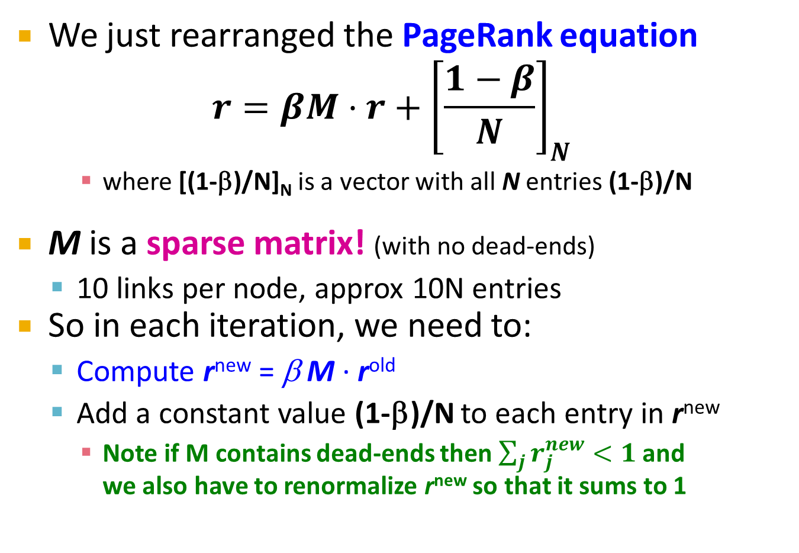
Sparse Matrix Formulation
We just rearranged the PageRank equation
$$r=βM⋅r+{\left[\frac{1−β}{N}\right]}_{N}$$
where [(1-β)/N]_{N} is a vector with all N entries (1-β)/N
M is a sparse matrix! (with no dead-ends)
10 links per node, approx 10N entries
So in each iteration, we need to:
Compute r^{new} = β M ∙ r^{old}
Add a constant value (1-β)/N to each entry in r^{new}
Note if M contains dead-ends then $\sum_{j}{r_{j}^{new}}<1$ and we also have to renormalize r^{new} so that it sums to 1

Slide 52
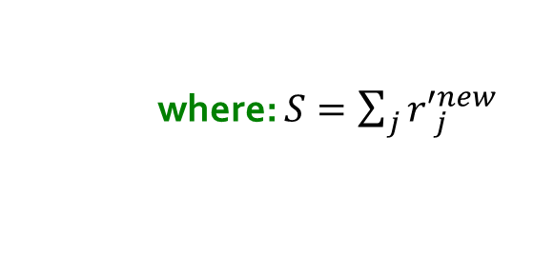
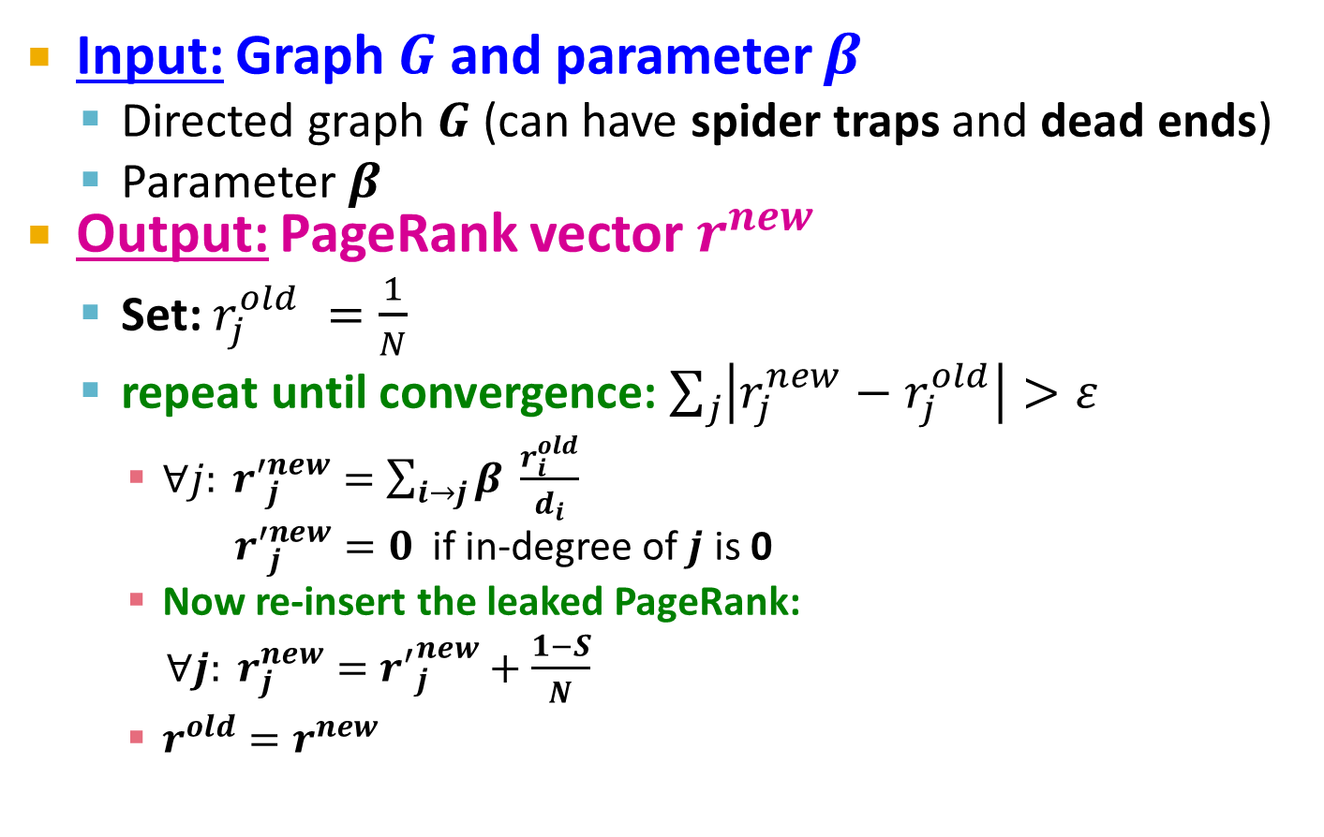
PageRank: The Complete Algorithm
Input: Graph $G$ and parameter $β$
Directed graph $G$ (can have spider traps and dead ends)
Parameter $β$
Output: PageRank vector $r^{new}$
Set: $r_{j}^{old} =\frac{1}{N}$
repeat until convergence: $\sum_{j}{\left|r_{j}^{new}−r_{j}^{old}\right|>ε}$
$∀j: {r′}_{j}^{new}=\sum_{i→j}{β \frac{r_{i}^{old}}{d_{i}}}$
${r′}_{j}^{new}=0$ if in-degree of $j$ is 0
Now re-insert the leaked PageRank:
$∀j: r_{j}^{new}={r^{′}}_{j}^{new}+\frac{1−S}{N}$
$r^{old}=r^{new}$
where: $S=\sum_{j}{{r′}_{j}^{new}}$
If the graph has no dead-ends then the amount of leaked PageRank is 1-β. But since we have dead-ends the amount of leaked PageRank may be larger. We have to explicitly account for it by computing S.

Slide 53
Sparse Matrix Encoding
Encode sparse matrix using only nonzero entries
Space proportional roughly to number of links
Say 10N, or 4*10*1 billion = 40GB
Still won’t fit in memory, but will fit on disk
source
node
degree
destination nodes
0 | 3 | 1, 5, 7
1 | 5 | 17, 64, 113, 117, 245
2 | 2 | 13, 23

Slide 54
Basic Algorithm: Update Step
Assume enough RAM to fit r^{new} into memory
Store r^{old} and matrix M on disk
1 step of power-iteration is:
Initialize all entries of r^{new} = (1-β) / N
For each page i (of out-degree d_{i}):
Read into memory: i, d_{i}, dest₁, …, dest_{di}, r^{old}(i)
For j = 1…d_{i}
r^{new}(dest_{j}) += β r^{old}(i) / d_{i}
0
r^{new}
source
degree
destination
r^{old}
0
1
0 | 3 | 1, 5, 6
1 | 4 | 17, 64, 113, 117
2 | 2 | 13, 23
1
2
2
3
3
4
4
5
5
6
6
Notes:
Remember to say that we first initialize r^new to 1-beta/n

Slide 55
Analysis
Assume enough RAM to fit r^{new} into memory
Store r^{old} and matrix M on disk
In each iteration, we have to:
Read r^{old} and M
Write r^{new} back to disk
Cost per iteration of Power method: = 2|r| + |M|
Question:
What if we could not even fit r^{new} in memory?

Slide 56
Example of a chart
This is an example of a chart

Slide 57
Block-based Update Algorithm
r^{new}
src
degree
destination
r^{old}
0
0 | 4 | 0, 1, 3, 5
1 | 2 | 0, 5
2 | 2 | 3, 4
0
1
1
2
2
3
4
3
M
5
4
5
Break r^{new} into k blocks that fit in memory
Scan M and r^{old} once for each block

Slide 58
Analysis of Block Update
Similar to nested-loop join in databases
Break r^{new} into k blocks that fit in memory
Scan M and r^{old} once for each block
Total cost:
k scans of M and r^{old}
Cost per iteration of Power method: k(|M| + |r|) + |r| = k|M| + (k+1)|r|
Can we do better?
Hint: M is much bigger than r (approx 10-20x), so we must avoid reading it k times per iteration

Slide 59
Block-Stripe Update Algorithm
src
degree
destination
r^{new}
0 | 4 | 0, 1
1 | 3 | 0
2 | 2 | 1
0
1
r^{old}
0
1
2
2
0 | 4 | 3
2 | 2 | 3
3
4
3
5
0 | 4 | 5
1 | 3 | 5
2 | 2 | 4
4
5
Break M into stripes! Each stripe contains only destination nodes in the corresponding block of r^{new}

Slide 60
Block-Stripe Analysis
Break M into stripes
Each stripe contains only destination nodes in the corresponding block of r^{new}
Some additional overhead per stripe
But it is usually worth it
Cost per iteration of Power method: =|M|(1+ε) + (k+1)|r|

Slide 61
Some Problems with Page Rank
Measures generic popularity of a page
Biased against topic-specific authorities
Solution: Topic-Specific PageRank (next)
Uses a single measure of importance
Other models of importance
Solution: Hubs-and-Authorities
Susceptible to Link spam
Artificial link topographies created in order to boost page rank
Solution: TrustRank

Slide 62
Analysis of Large Graphs: TrustRank and WebSpam
Note to other teachers and users of these slides: We would be delighted if you found this our material useful in giving your own lectures. Feel free to use these slides verbatim, or to modify them to fit your own needs. If you make use of a significant portion of these slides in your own lecture, please include this message, or a link to our web site: http://www.mmds.org
Mining of Massive Datasets
Jure Leskovec, Anand Rajaraman, Jeff Ullman Stanford University
http://www.mmds.org

Slide 63
Example: PageRank Scores
B
38.4
C
34.3
A
3.3
D
3.9
E
8.1
F
3.9
1.6
1.6
1.6
1.6
1.6

Slide 64
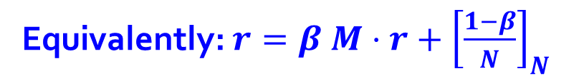
Random Teleports (β = 0.8)
M
[1/N]_{NxN}
0.8·½+0.2·⅓
y
1/2 1/2 0
1/2 0 0
0 1/2 1
1/3 1/3 1/3
1/3 1/3 1/3
1/3 1/3 1/3
0.8
+ 0.2
0.8·½+0.2·⅓
0.2·⅓
0.8·½+0.2·⅓
0.2· ⅓
y 7/15 7/15 1/15
a 7/15 1/15 1/15
m 1/15 7/15 13/15
0.8+0.2·⅓
a
0.8·½+0.2·⅓
m
0.2·⅓
0.2· ⅓
A
y
a =
m
1/3
1/3
1/3
0.33
0.20
0.46
0.24
0.20
0.52
0.26
0.18
0.56
7/33
5/33
21/33
. . .
r = A r
Equivalently: $r=β M⋅r+{\left[\frac{1−β}{N}\right]}_{N}$

Slide 65
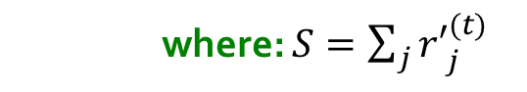
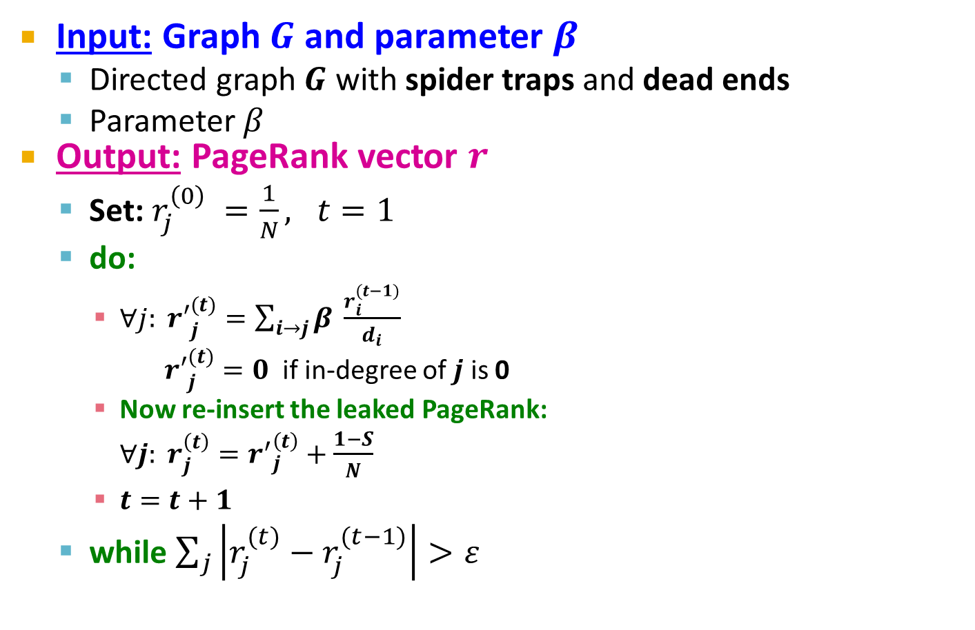
PageRank: The Complete Algorithm
Input: Graph $G$ and parameter $β$
Directed graph $G$ with spider traps and dead ends
Parameter $β$
Output: PageRank vector $r$
Set: $r_{j}^{\left(0\right)} =\frac{1}{N}, t=1$
do:
$∀j: {r′}_{j}^{(t)}=\sum_{i→j}{β \frac{r_{i}^{(t−1)}}{d_{i}}}$
${r′}_{j}^{(t)}=0$ if in-degree of $j$ is 0
Now re-insert the leaked PageRank:
$∀j: r_{j}^{\left(t\right)}={r^{′}}_{j}^{\left(t\right)}+\frac{1−S}{N}$
$t=t+1$
while $\sum_{j}{\left|r_{j}^{(t)}−r_{j}^{(t−1)}\right|>ε}$
If the graph has no dead-ends then the amount of leaked PageRank is 1-β. But since we have dead-ends the amount of leaked PageRank may be larger. We have to explicitly account for it by computing S.
where: $S=\sum_{j}{{r′}_{j}^{(t)}}$

Slide 66
Some Problems with PageRank
Measures generic popularity of a page
Will ignore/miss topic-specific authorities
Solution: Topic-Specific PageRank (next)
Uses a single measure of importance
Other models of importance
Solution: Hubs-and-Authorities
Susceptible to Link spam
Artificial link topographies created in order to boost page rank
Solution: TrustRank

Slide 67
Topic-Specific PageRank

Slide 68
Topic-Specific PageRank
Instead of generic popularity, can we measure popularity within a topic?
Goal: Evaluate Web pages not just according to their popularity, but by how close they are to a particular topic, e.g. “sports” or “history”
Allows search queries to be answered based on interests of the user
Example: Query “Trojan” wants different pages depending on whether you are interested in sports, history and computer security

Slide 69
Topic-Specific PageRank
Random walker has a small probability of teleporting at any step
Teleport can go to:
Standard PageRank: Any page with equal probability
To avoid dead-end and spider-trap problems
Topic Specific PageRank: A topic-specific set of “relevant” pages (teleport set)
Idea: Bias the random walk
When walker teleports, she pick a page from a set S
S contains only pages that are relevant to the topic
E.g., Open Directory (DMOZ) pages for a given topic/query
For each teleport set S, we get a different vector r_{S}

Slide 70
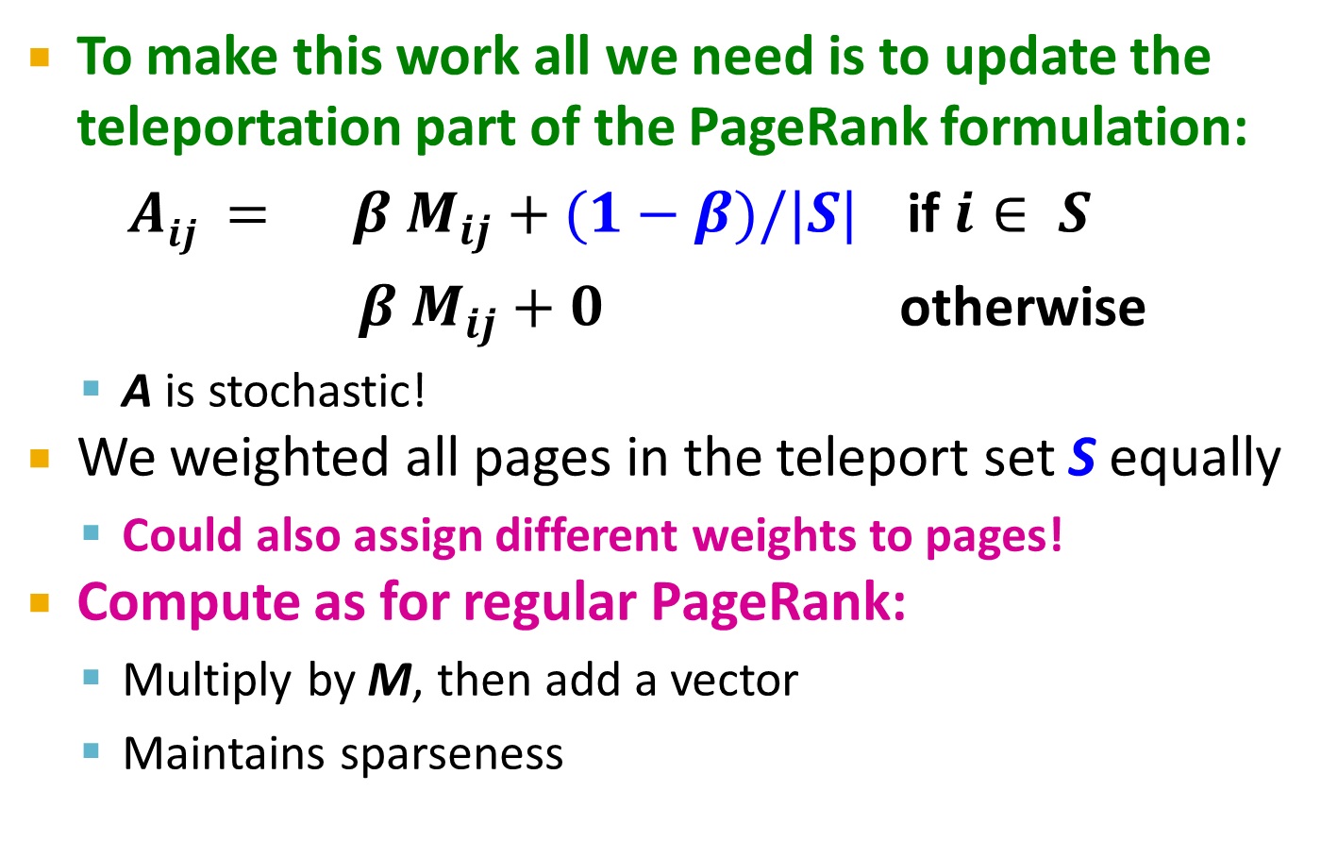
Matrix Formulation
To make this work all we need is to update the teleportation part of the PageRank formulation:
$Aij = β M_{ij}+(1−β)/|S|$ if $i∈ S$
$β M_{ij}+0$ otherwise
A is stochastic!
We weighted all pages in the teleport set S equally
Could also assign different weights to pages!
Compute as for regular PageRank:
Multiply by M, then add a vector
Maintains sparseness

Slide 71
Example: Topic-Specific PageRank
Suppose S = {1}, β = 0.8
0.2
0.5
1
Node Iteration
0 1 2 … stable
1 0.25 0.4 0.28 0.294
2 0.25 0.1 0.16 0.118
3 0.25 0.3 0.32 0.327
4 0.25 0.2 0.24 0.261
0.4
0.5
0.4
1
2
3
0.8
1
1
0.8
0.8
4
S={1,2,3,4}, β=0.8:
r=[0.13, 0.10, 0.39, 0.36]
S={1,2,3} , β=0.8:
r=[0.17, 0.13, 0.38, 0.30]
S={1,2} , β=0.8:
r=[0.26, 0.20, 0.29, 0.23]
S={1} , β=0.8:
r=[0.29, 0.11, 0.32, 0.26]
S={1}, β=0.90:
r=[0.17, 0.07, 0.40, 0.36]
S={1} , β=0.8:
r=[0.29, 0.11, 0.32, 0.26]
S={1}, β=0.70:
r=[0.39, 0.14, 0.27, 0.19]

Slide 72
Discovering the Topic Vector S
Create different PageRanks for different topics
The 16 DMOZ top-level categories:
arts, business, sports,…
Which topic ranking to use?
User can pick from a menu
Classify query into a topic
Can use the context of the query
E.g., query is launched from a web page talking about a known topic
History of queries e.g., “basketball” followed by “Jordan”
User context, e.g., user’s bookmarks, …

Slide 73
Application to Measuring Proximity in Graphs
Random Walk with Restarts: S is a single element

Slide 74
Proximity on Graphs
[Tong-Faloutsos, ‘06]
a.k.a.: Relevance, Closeness, ‘Similarity’…

Slide 75
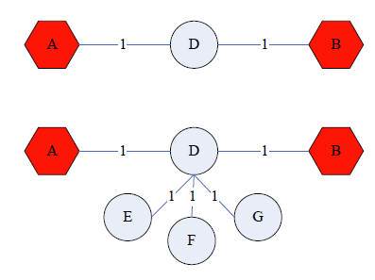
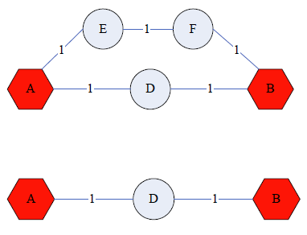
Good proximity measure?
Shortest path is not good:
No effect of degree-1 nodes (E, F, G)!
Multi-faceted relationships

Slide 76
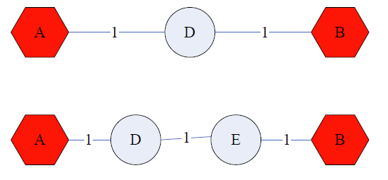
Good proximity measure?
Network flow is not good:
Does not punish long paths

Slide 77
What is good notion of proximity?
[Tong-Faloutsos, ‘06]
Multiple connections
Quality of connection
Direct & Indirect connections
Length, Degree, Weight…
…

Slide 78
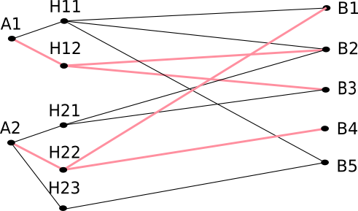
SimRank: Idea
SimRank: Random walks from a fixed node on k-partite graphs
Setting: k-partite graph with k types of nodes
E.g.: Authors, Conferences, Tags
Topic Specific PageRank from node u: teleport set S = {u}
Resulting scores measures similarity to node u
Problem:
Must be done once for each node u
Suitable for sub-Web-scale applications
Authors
Conferences
Tags

Slide 79
SimRank: Example
…
…
Q: What is most related
conference to ICDM?
A: Topic-Specific PageRank with teleport set S={ICDM}
…
…
Conference
Author

Slide 80
SimRank: Example

Slide 81
PageRank: Summary
“Normal” PageRank:
Teleports uniformly at random to any node
All nodes have the same probability of surfer landing there: S = [0.1, 0.1, 0.1, 0.1, 0.1, 0.1, 0.1, 0.1, 0.1, 0.1]
Topic-Specific PageRank also known as Personalized PageRank:
Teleports to a topic specific set of pages
Nodes can have different probabilities of surfer landing there: S = [0.1, 0, 0, 0.2, 0, 0, 0.5, 0, 0, 0.2]
Random Walk with Restarts:
Topic-Specific PageRank where teleport is always to the same node. S=[0, 0, 0, 0, 1, 0, 0, 0, 0, 0, 0]

Slide 82
TrustRank: Combating the Web Spam

Slide 83
What is Web Spam?
Spamming:
Any deliberate action to boost a web page’s position in search engine results, incommensurate with page’s real value
Spam:
Web pages that are the result of spamming
This is a very broad definition
SEO industry might disagree!
SEO = search engine optimization
Approximately 10-15% of web pages are spam

Slide 84
Web Search
Early search engines:
Crawl the Web
Index pages by the words they contained
Respond to search queries (lists of words) with the pages containing those words
Early page ranking:
Attempt to order pages matching a search query by “importance”
First search engines considered:
(1) Number of times query words appeared
(2) Prominence of word position, e.g. title, header

Slide 85
First Spammers
As people began to use search engines to find things on the Web, those with commercial interests tried to exploit search engines to bring people to their own site – whether they wanted to be there or not
Example:
Shirt-seller might pretend to be about “movies”
Techniques for achieving high relevance/importance for a web page

Slide 86
First Spammers: Term Spam
How do you make your page appear to be about movies?
(1) Add the word movie 1,000 times to your page
Set text color to the background color, so only search engines would see it
(2) Or, run the query “movie” on your target search engine
See what page came first in the listings
Copy it into your page, make it “invisible”
These and similar techniques are term spam
Notes:
Do not forget to tell the joke "I used to do this when I was young" when talking about point (1) :D

Slide 87
Google’s Solution to Term Spam
Believe what people say about you, rather than what you say about yourself
Use words in the anchor text (words that appear underlined to represent the link) and its surrounding text
PageRank as a tool to measure the “importance” of Web pages

Slide 88
Why It Works?
Our hypothetical shirt-seller looses
Saying he is about movies doesn’t help, because others don’t say he is about movies
His page isn’t very important, so it won’t be ranked high for shirts or movies
Example:
Shirt-seller creates 1,000 pages, each links to his with “movie” in the anchor text
These pages have no links in, so they get little PageRank
So the shirt-seller can’t beat truly important movie pages, like IMDB

Slide 89
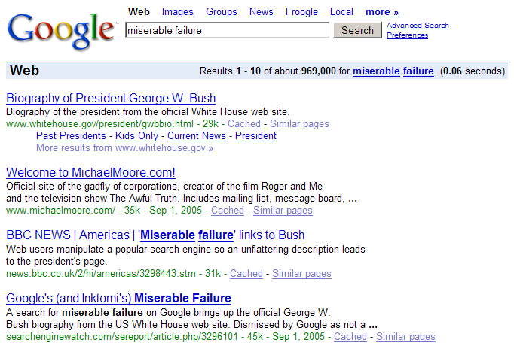
Why it does not work?

Slide 90
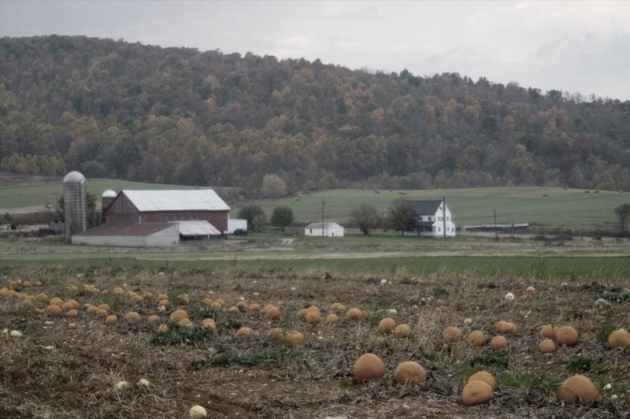
SPAM FARMING

Slide 91

Google vs. Spammers: Round 2!
Once Google became the dominant search engine, spammers began to work out ways to fool Google
Spam farms were developed to concentrate PageRank on a single page
Link spam:
Creating link structures that boost PageRank of a particular page

Slide 92
Link Spamming
Three kinds of web pages from a spammer’s point of view
Inaccessible pages
Accessible pages
e.g., blog comments pages
spammer can post links to his pages
Owned pages
Completely controlled by spammer
May span multiple domain names

Slide 93
Link Farms
Spammer’s goal:
Maximize the PageRank of target page t
Technique:
Get as many links from accessible pages as possible to target page t
Construct “link farm” to get PageRank multiplier effect

Slide 94
Link Farms
Accessible
Owned
Inaccessible
1
t
2
M
Millions of farm pages
One of the most common and effective organizations for a link farm

Slide 95
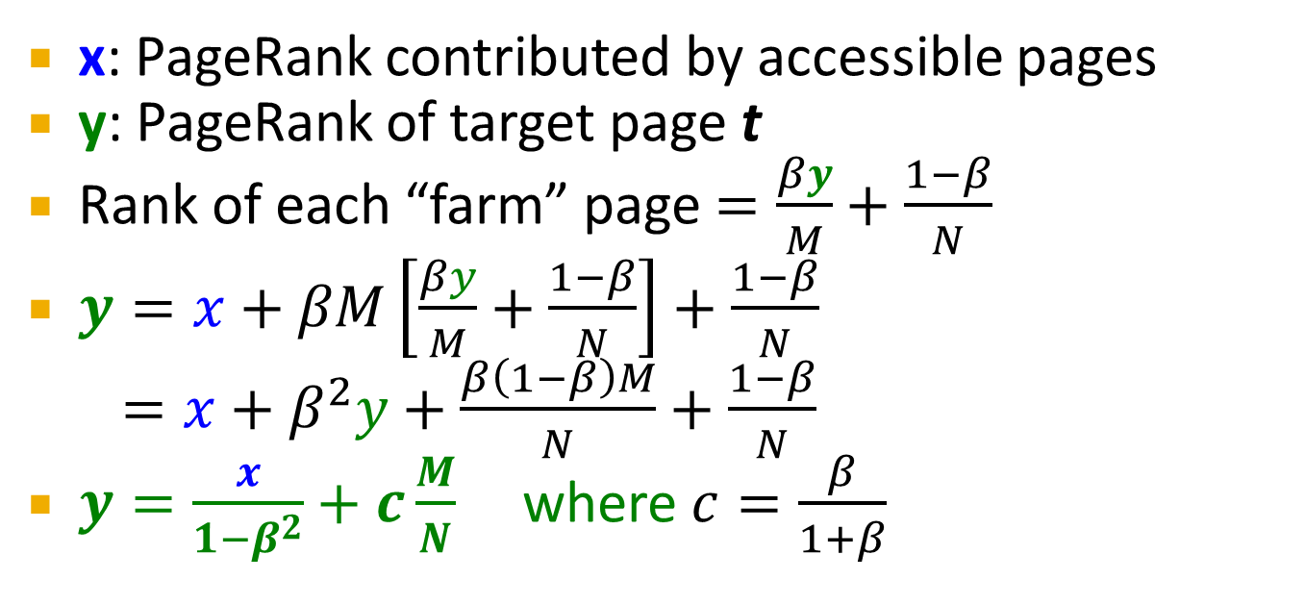
Analysis
Accessible
Owned
Inaccessible
1
t
2
N…# pages on the web
M…# of pages spammer owns
M
x: PageRank contributed by accessible pages
y: PageRank of target page t
Rank of each “farm” page $=\frac{βy}{M}+\frac{1−β}{N}$
$y=x+βM\left[\frac{βy}{M}+\frac{1−β}{N}\right]+\frac{1−β}{N}$
$=x+β^{2}y+\frac{β\left(1−β\right)M}{N}+\frac{1−β}{N}$
$y=\frac{x}{1−β^{2}}+c\frac{M}{N}$ where $c=\frac{β}{1+β}$
Very small; ignore Now we solve for y

Slide 96
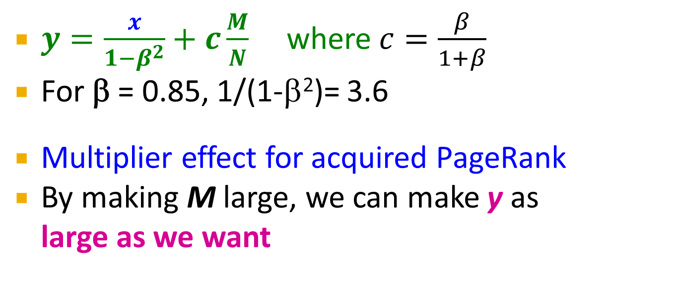
Analysis
Accessible
Owned
Inaccessible
1
t
2
N…# pages on the web
M…# of pages spammer owns
M
$y=\frac{x}{1−β^{2}}+c\frac{M}{N}$ where $c=\frac{β}{1+β}$
For β = 0.85, 1/(1-β²)= 3.6
Multiplier effect for acquired PageRank
By making M large, we can make y as large as we want

Slide 97
TrustRank: Combating the Web Spam

Slide 98
Combating Spam
Combating term spam
Analyze text using statistical methods
Similar to email spam filtering
Also useful: Detecting approximate duplicate pages
Combating link spam
Detection and blacklisting of structures that look like spam farms
Leads to another war – hiding and detecting spam farms
TrustRank = topic-specific PageRank with a teleport set of trusted pages
Example: .edu domains, similar domains for non-US schools

Slide 99
TrustRank: Idea
Basic principle: Approximate isolation
It is rare for a “good” page to point to a “bad” (spam) page
Sample a set of seed pages from the web
Have an oracle (human) to identify the good pages and the spam pages in the seed set
Expensive task, so we must make seed set as small as possible

Slide 100
Trust Propagation
Call the subset of seed pages that are identified as good the trusted pages
Perform a topic-sensitive PageRank with teleport set = trusted pages
Propagate trust through links:
Each page gets a trust value between 0 and 1
Solution 1: Use a threshold value and mark all pages below the trust threshold as spam

Slide 101
Simple Model: Trust Propagation
Set trust of each trusted page to 1
Suppose trust of page p is t_{p}
Page p has a set of out-links o_{p}
For each q∈o_{p}, p confers the trust to q
β t_{p} /|o_{p}| for 0 <β < 1
Trust is additive
Trust of p is the sum of the trust conferred on p by all its in-linked pages
Note similarity to Topic-Specific PageRank
Within a scaling factor, TrustRank = PageRank with trusted pages as teleport set

Slide 102
Why is it a good idea?
Trust attenuation:
The degree of trust conferred by a trusted page decreases with the distance in the graph
Trust splitting:
The larger the number of out-links from a page, the less scrutiny the page author gives each out-link
Trust is split across out-links

Slide 103
Picking the Seed Set
Two conflicting considerations:
Human has to inspect each seed page, so seed set must be as small as possible
Must ensure every good page gets adequate trust rank, so need make all good pages reachable from seed set by short paths

Slide 104
Approaches to Picking Seed Set
Suppose we want to pick a seed set of k pages
How to do that?
(1) PageRank:
Pick the top k pages by PageRank
Theory is that you can’t get a bad page’s rank really high
(2) Use trusted domains whose membership is controlled, like .edu, .mil, .gov

Slide 105
Spam Mass
In the TrustRank model, we start with good pages and propagate trust
Complementary view:
What fraction of a page’s PageRank comes from spam pages?
In practice, we don’t know all the spam pages, so we need to estimate
Trusted set
Web

Slide 106
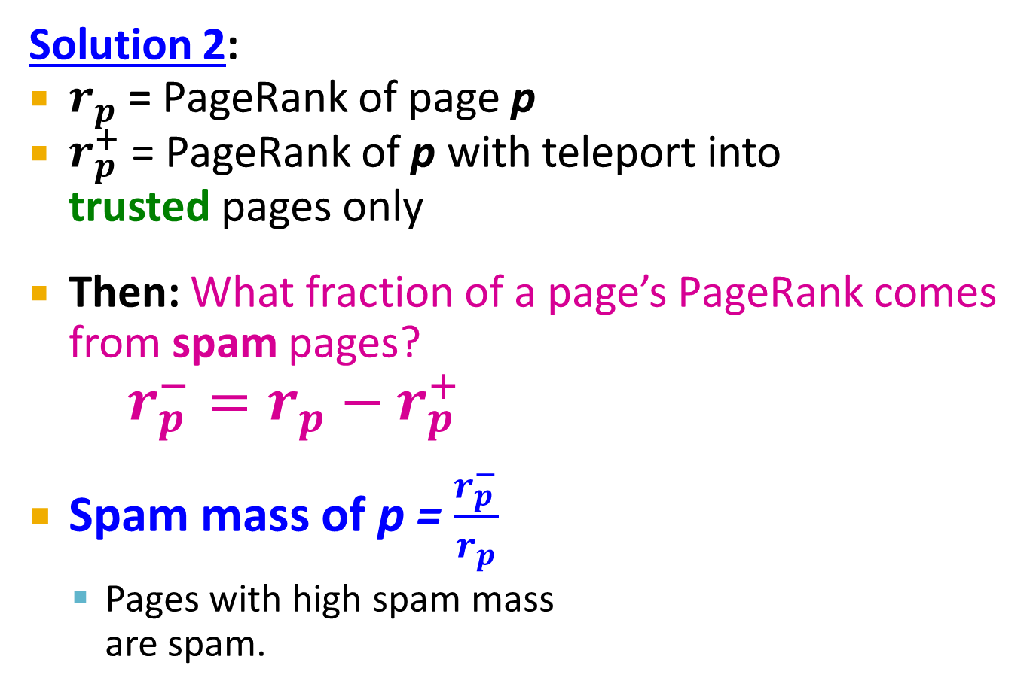
Spam Mass Estimation
Solution 2:
$r_{p}$ = PageRank of page p
$r_{p}^{+}$ = PageRank of p with teleport into trusted pages only
Then: What fraction of a page’s PageRank comes from spam pages?
$r_{p}^{−}=r_{p}−r_{p}^{+}$
Spam mass of p = $\frac{r_{p}^{−}}{r_{p}}$
Pages with high spam mass are spam.
Trusted set
Web

Slide 107
HITS: Hubs and Authorities

Slide 108
Hubs and Authorities
HITS (Hypertext-Induced Topic Selection)
Is a measure of importance of pages or documents, similar to PageRank
Proposed at around same time as PageRank (‘98)
Goal: Say we want to find good newspapers
Don’t just find newspapers. Find “experts” – people who link in a coordinated way to good newspapers
Idea: Links as votes
Page is more important if it has more links
In-coming links? Out-going links?

Slide 109
Finding newspapers
Hubs and Authorities Each page has 2 scores:
Quality as an expert (hub):
Total sum of votes of authorities pointed to
Quality as a content (authority):
Total sum of votes coming from experts
Principle of repeated improvement
NYT: 10
Ebay: 3
Yahoo: 3
CNN: 8
WSJ: 9

Slide 110
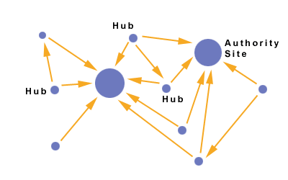
Hubs and Authorities
Interesting pages fall into two classes:
Authorities are pages containing useful information
Newspaper home pages
Course home pages
Home pages of auto manufacturers
Hubs are pages that link to authorities
List of newspapers
Course bulletin
List of US auto manufacturers

Slide 111
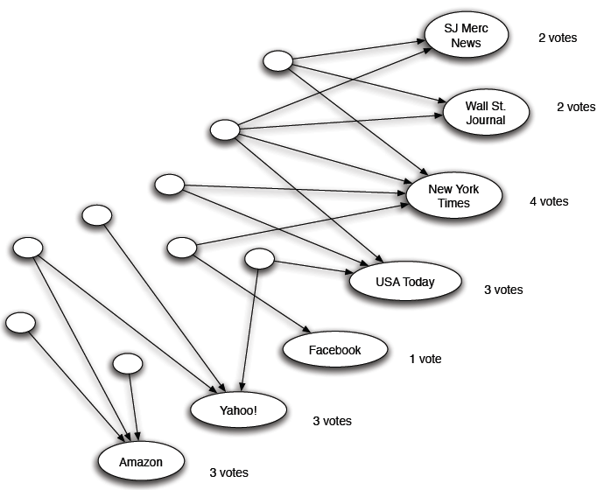
Counting in-links: Authority
Each page starts with hub score 1. Authorities collect their votes
(Note this is idealized example. In reality graph is not bipartite and each page has both the hub and authority score)

Slide 112
Counting in-links: Authority
Sum of hub scores of nodes pointing to NYT.
Each page starts with hub score 1. Authorities collect their votes
(Note this is idealized example. In reality graph is not bipartite and each page has both the hub and authority score)

Slide 113
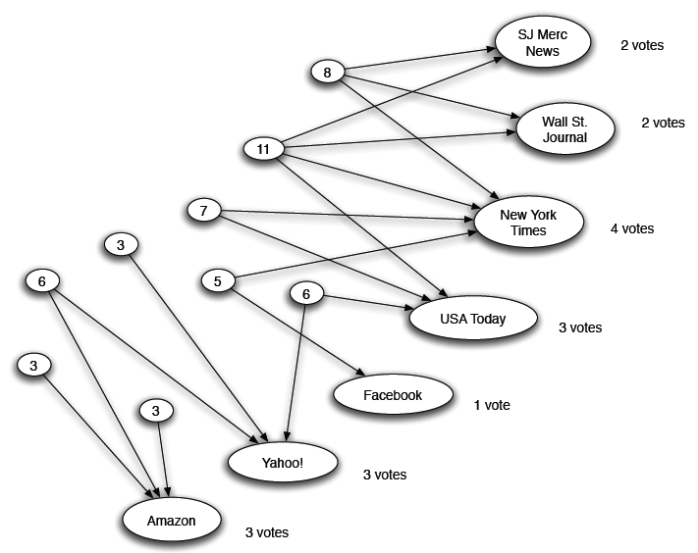
Expert Quality: Hub
Sum of authority scores of nodes that the node points to.
Hubs collect authority scores
(Note this is idealized example. In reality graph is not bipartite and each page has both the hub and authority score)

Slide 114
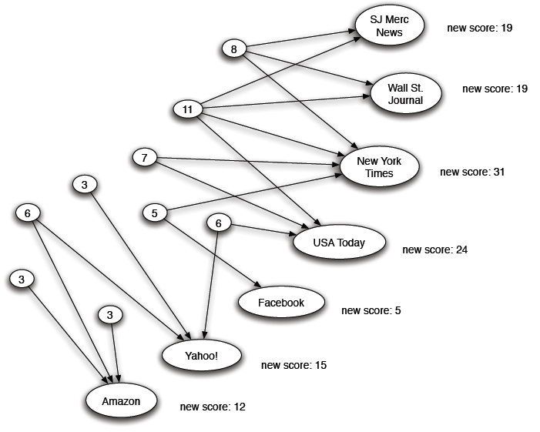
Reweighting
Authorities again collect the hub scores
(Note this is idealized example. In reality graph is not bipartite and each page has both the hub and authority score)

Slide 115
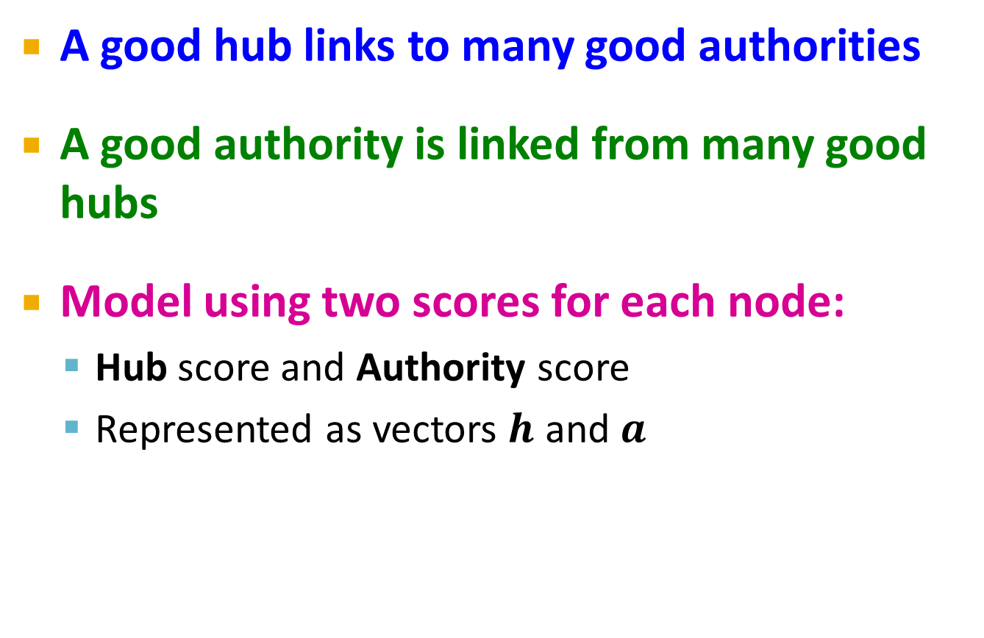
Mutually Recursive Definition
A good hub links to many good authorities
A good authority is linked from many good hubs
Model using two scores for each node:
Hub score and Authority score
Represented as vectors $h$ and $a$

Slide 116
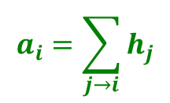
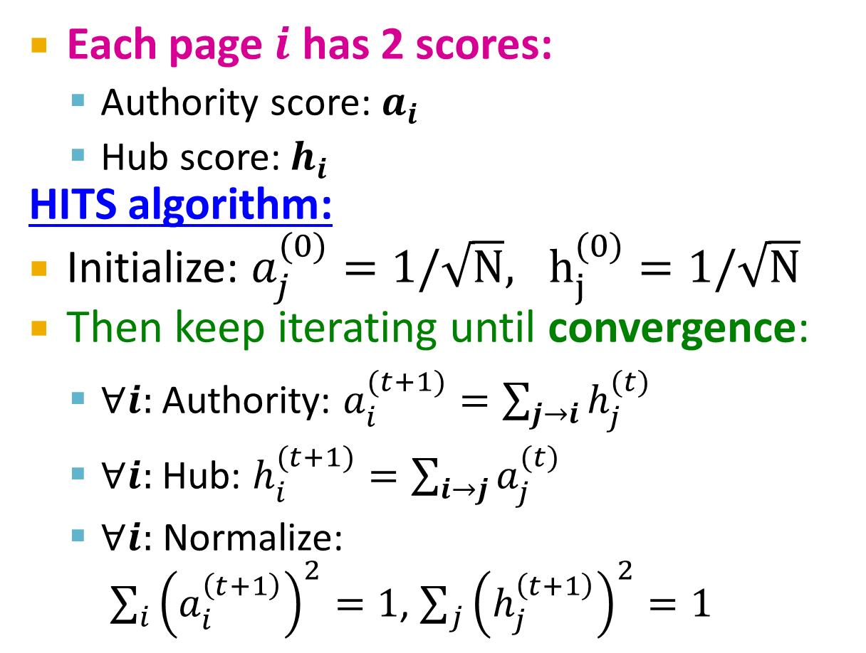
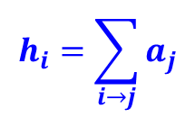
Hubs and Authorities
[Kleinberg ‘98]
j₁
j₂
j₃
j₄
Each page $i$ has 2 scores:
Authority score: $a_{i}$
Hub score: $h_{i}$
HITS algorithm:
Initialize: $a_{j}^{(0)}=1/\sqrt{N}, h_{j}^{(0)}=1/\sqrt{N}$
Then keep iterating until convergence:
$∀i:$Authority: $a_{i}^{(t+1)}=\sum_{j→i}{h_{j}^{(t)}}$
$∀i:$Hub: $h_{i}^{(t+1)}=\sum_{i→j}{a_{j}^{(t)}}$
$∀i:$ Normalize: $\sum_{i}{{\left(a_{i}^{\left(t+1\right)}\right)}^{2}}=1$, $\sum_{j}{{\left(h_{j}^{\left(t+1\right)}\right)}^{2}}=1$
i
$$a_{i}=\sum_{j→i}{h_{j}}$$
i
j₁
j₂
j₃
j₄
$$h_{i}=\sum_{i→j}{a_{j}}$$

Slide 117
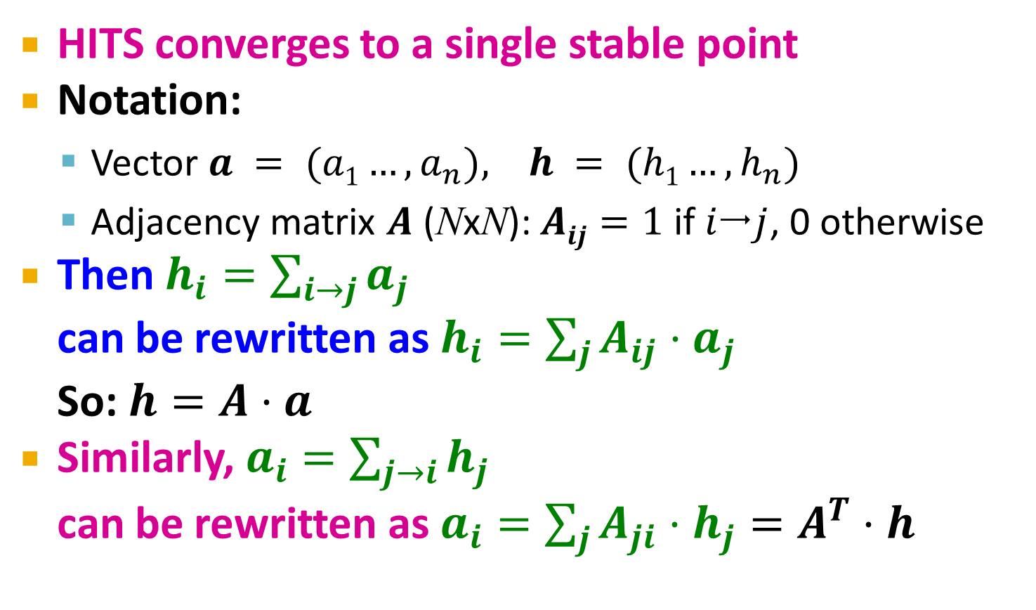
Hubs and Authorities
[Kleinberg ‘98]
HITS converges to a single stable point
Notation:
Vector $a = (a1…,a_{n}), h = (h1…,h_{n})$
Adjacency matrix $A$ (NxN): $Aij=1$ if $ij$, 0 otherwise
Then $h_{i}=\sum_{i→j}{a_{j}}$ can be rewritten as $h_{i}=\sum_{j}{A_{ij}⋅a_{j}}$ So: $h=A⋅a$
Similarly, $a_{i}=\sum_{j→i}{h_{j}}$ can be rewritten as $a_{i}=\sum_{j}{A_{ji}⋅h_{j}}=A^{T}⋅h$

Slide 118

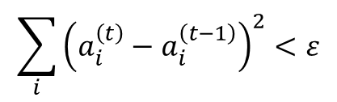
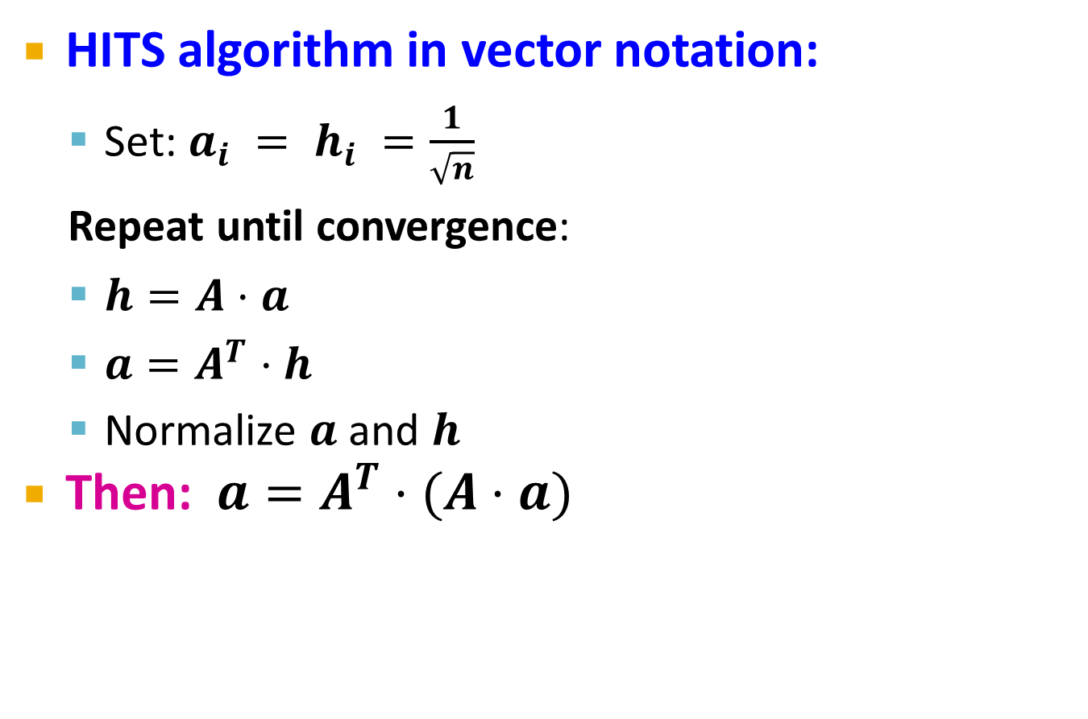



Hubs and Authorities
HITS algorithm in vector notation:
Set: $a_{i} = h_{i} =\frac{1}{\sqrt{n}}$
Repeat until convergence:
$h=A⋅a$
$a=A^{T}⋅h$
Normalize $a$ and $h$
Then: $a=A^{T}⋅(A⋅a)$
Convergence criterion:
$$\sum_{i}{{\left(h_{i}^{\left(t\right)}−h_{i}^{\left(t−1\right)}\right)}^{2}}<ε$$
$$\sum_{i}{{\left(a_{i}^{\left(t\right)}−a_{i}^{\left(t−1\right)}\right)}^{2}}<ε$$
$a$ is updated (in 2 steps):
$a=A^{T}(A a)=(A^{T}A) a$
h is updated (in 2 steps):
$$h=A (A^{T}h)=(A{ A}^{T}) h$$
new $h$
new $a$
Repeated matrix powering

Slide 119
Existence and Uniqueness
h = λ A a
a = μ A^{T} h
h = λ μ A A^{T} h
a = λ μ A^{T} A a
Under reasonable assumptions about A, HITS converges to vectors h* and a*:
h* is the principal eigenvector of matrix A A^{T}
a* is the principal eigenvector of matrix A^{T} A
λ = 1 / ∑h_{i}
μ = 1 / ∑a_{i}

Slide 120
Example of HITS
1 1 1
A = 1 0 1
0 1 0
1 1 0
A^{T} = 1 0 1
1 1 0
Yahoo
Amazon
M’soft
h(yahoo)
h(amazon)
h(m’soft)
=
=
=
.58
.58
.58
.80
.53
.27
.80
.53
.27
.79
.57
.23
. . .
. . .
. . .
.788
.577
.211
a(yahoo) = .58
a(amazon) = .58
a(m’soft) = .58
.58
.58
.58
.62
.49
.62
.62
.49
.62
. . .
. . .
. . .
.628
.459
.628

Slide 121
PageRank and HITS
PageRank and HITS are two solutions to the same problem:
What is the value of an in-link from u to v?
In the PageRank model, the value of the link depends on the links into u
In the HITS model, it depends on the value of the other links out of u
The destinies of PageRank and HITS post-1998 were very different

Slide 122
Advertising on the Web
Note to other teachers and users of these slides: We would be delighted if you found this our material useful in giving your own lectures. Feel free to use these slides verbatim, or to modify them to fit your own needs. If you make use of a significant portion of these slides in your own lecture, please include this message, or a link to our web site: http://www.mmds.org
Mining of Massive Datasets
Jure Leskovec, Anand Rajaraman, Jeff Ullman Stanford University
http://www.mmds.org

Slide 123
Online Algorithms
Classic model of algorithms
You get to see the entire input, then compute some function of it
In this context, “offline algorithm”
Online Algorithms
You get to see the input one piece at a time, and need to make irrevocable decisions along the way
Similar to the data stream model

Slide 124
Online Bipartite Matching

Slide 125
Example: Bipartite Matching
1
a
2
b
3
c
Boys
4
d
Girls
Nodes: Boys and Girls; Edges: Preferences
Goal: Match boys to girls so that maximum number of preferences is satisfied

Slide 126
Example: Bipartite Matching
1
a
2
b
3
c
Boys
4
d
Girls
M = {(1,a),(2,b),(3,d)} is a matching
Cardinality of matching = |M| = 3

Slide 127
Example: Bipartite Matching
1
a
2
b
3
c
Boys
4
d
Girls
M = {(1,c),(2,b),(3,d),(4,a)} is a perfect matching
Perfect matching … all vertices of the graph are matched
Maximum matching … a matching that contains the largest possible number of matches

Slide 128
Matching Algorithm
Problem: Find a maximum matching for a given bipartite graph
A perfect one if it exists
There is a polynomial-time offline algorithm based on augmenting paths (Hopcroft & Karp 1973, see http://en.wikipedia.org/wiki/Hopcroft-Karp_algorithm)
But what if we do not know the entire graph upfront?

Slide 129
Online Graph Matching Problem
Initially, we are given the set boys
In each round, one girl’s choices are revealed
That is, girl’s edges are revealed
At that time, we have to decide to either:
Pair the girl with a boy
Do not pair the girl with any boy
Example of application: Assigning tasks to servers

Slide 130
Online Graph Matching: Example
1
a
(1,a)
2
b
(2,b)
(3,d)
3
c
4
d

Slide 131
Greedy Algorithm
Greedy algorithm for the online graph matching problem:
Pair the new girl with any eligible boy
If there is none, do not pair girl
How good is the algorithm?

Slide 132
Competitive Ratio
For input I, suppose greedy produces matching M_{greedy} while an optimal matching is M_{opt}
Competitive ratio =
min_{all possible inputs I} (|M_{greedy}|/|M_{opt}|)
(what is greedy’s worst performance over all possible inputs I)

Slide 133
Analyzing the Greedy Algorithm
Consider a case: M_{greedy}≠ M_{opt}
Consider the set G of girls matched in M_{opt} but not in M_{greedy}
Then every boy B adjacent to girls in G is already matched in M_{greedy}:
If there would exist such non-matched (by M_{greedy}) boy adjacent to a non-matched girl then greedy would have matched them
Since boys B are already matched in M_{greedy} then (1) |M_{greedy}|≥ |B|
M_{opt}
1
a
M_{greedy}
2
b
3
c
4
d
B={ }
G={ }

Slide 134
Analyzing the Greedy Algorithm
M_{opt}
Summary so far:
Girls G matched in M_{opt} but not in M_{greedy}
(1) |M_{greedy}|≥ |B|
There are at least |G| such boys (|G| ≤ |B|) otherwise the optimal algorithm couldn’t have matched all girls in G
So: |G| ≤ |B| ≤ |M_{greedy}|
By definition of G also: |M_{opt}| ≤ |M_{greedy}| + |G|
Worst case is when |G| = |B| = |M_{greedy}|
|M_{opt}| ≤ 2|M_{greedy}| then |M_{greedy}|/|M_{opt}| ≥ 1/2
1
a
M_{greedy}
2
b
3
c
4
d
B={ }
G={ }
Notes:
This is a general proof.
We make no assumptions about the structure of the bipartite graph.

Slide 135
Worst-case Scenario
1
a
(1,a)
2
b
(2,b)
3
c
4
d

Slide 136
Web Advertising

Slide 137

History of Web Advertising
Banner ads (1995-2001)
Initial form of web advertising
Popular websites charged X$ for every 1,000 “impressions” of the ad
Called “CPM” rate (Cost per thousand impressions)
Modeled similar to TV, magazine ads
From untargeted to demographically targeted
Low click-through rates
Low ROI for advertisers
CPM…cost per mille
Mille…thousand in Latin

Slide 138
Performance-based Advertising
Introduced by Overture around 2000
Advertisers bid on search keywords
When someone searches for that keyword, the highest bidder’s ad is shown
Advertiser is charged only if the ad is clicked on
Similar model adopted by Google with some changes around 2002
Called Adwords

Slide 139


Ads vs. Search Results

Slide 140
Web 2.0
Performance-based advertising works!
Multi-billion-dollar industry
Interesting problem: What ads to show for a given query?
(Today’s lecture)
If I am an advertiser, which search terms should I bid on and how much should I bid?
(Not focus of today’s lecture)

Slide 141
Adwords Problem
Given:
1. A set of bids by advertisers for search queries
2. A click-through rate for each advertiser-query pair
3. A budget for each advertiser (say for 1 month)
4. A limit on the number of ads to be displayed with each search query
Respond to each search query with a set of advertisers such that:
1. The size of the set is no larger than the limit on the number of ads per query
2. Each advertiser has bid on the search query
3. Each advertiser has enough budget left to pay for the ad if it is clicked upon

Slide 142
Adwords Problem
A stream of queries arrives at the search engine: q₁, q₂, …
Several advertisers bid on each query
When query q_{i} arrives, search engine must pick a subset of advertisers whose ads are shown
Goal: Maximize search engine’s revenues
Simple solution: Instead of raw bids, use the “expected revenue per click” (i.e., Bid*CTR)
Clearly we need an online algorithm!

Slide 143
The Adwords Innovation
Advertiser
Bid
CTR
Bid * CTR
A
$1.00
1%
1 cent
B
$0.75
2%
1.5 cents
C
$0.50
2.5%
1.125 cents
Click through rate
Expected revenue

Slide 144
Complications: Budget
Two complications:
Budget
CTR of an ad is unknown
Each advertiser has a limited budget
Search engine guarantees that the advertiser will not be charged more than their daily budget

Slide 145
Complications: CTR
CTR: Each ad has a different likelihood of being clicked
Advertiser 1 bids $2, click probability = 0.1
Advertiser 2 bids $1, click probability = 0.5
Clickthrough rate (CTR) is measured historically
Very hard problem: Exploration vs. exploitation Exploit: Should we keep showing an ad for which we have good estimates of click-through rate or Explore: Shall we show a brand new ad to get a better sense of its click-through rate

Slide 146
Greedy Algorithm
Our setting: Simplified environment
There is 1 ad shown for each query
All advertisers have the same budget B
All ads are equally likely to be clicked
Value of each ad is the same (=1)
Simplest algorithm is greedy:
For a query pick any advertiser who has bid 1 for that query
Competitive ratio of greedy is 1/2

Slide 147
Bad Scenario for Greedy
Two advertisers A and B
A bids on query x, B bids on x and y
Both have budgets of $4
Query stream: x x x x y y y y
Worst case greedy choice: B B B B _ _ _ _
Optimal: A A A A B B B B
Competitive ratio = ½
This is the worst case!
Note: Greedy algorithm is deterministic – it always resolves draws in the same way
Notes:
Is greedy deterministic or randomized (it is deterministic!!)

Slide 148
BALANCE Algorithm [MSVV]
BALANCE Algorithm by Mehta, Saberi, Vazirani, and Vazirani
For each query, pick the advertiser with the largest unspent budget
Break ties arbitrarily (but in a deterministic way)

Slide 149
Example: BALANCE
Two advertisers A and B
A bids on query x, B bids on x and y
Both have budgets of $4
Query stream: x x x x y y y y
BALANCE choice: A B A B B B _ _
Optimal: A A A A B B B B
In general: For BALANCE on 2 advertisers Competitive ratio = ¾

Slide 150
Analyzing BALANCE
Consider simple case (w.l.o.g.):
2 advertisers, A₁ and A₂, each with budget B (≥1)
Optimal solution exhausts both advertisers’ budgets
BALANCE must exhaust at least one advertiser’s budget:
If not, we can allocate more queries
Whenever BALANCE makes a mistake (both advertisers bid on the query), advertiser’s unspent budget only decreases
Since optimal exhausts both budgets, one will for sure get exhausted
Assume BALANCE exhausts A₂’s budget, but allocates x queries fewer than the optimal
Revenue: BAL = 2B - x
Notes:
Why exhausts budget:
-- remember, optimal exhausts both budgets
GENERAL PROOF

Slide 151

Analyzing Balance
Queries allocated to A₁ in the optimal solution
B
Queries allocated to A₂ in the optimal solution
A₁
A₂
Optimal revenue = 2B
Assume Balance gives revenue = 2B-x = B+y
x
B
Unassigned queries should be assigned to A₂
(if we could assign to A₁ we would since we still have the budget)
Goal: Show we have y ≥ x
Case 1) ≤ ½ of A₁’s queries got assigned to A₂ then $y  B/2$
Case 2) > ½ of A₁’s queries got assigned to A₂ then $x≤B/2$ and $x+y=B$
Balance revenue is minimum for $x=y=B/2$
Minimum Balance revenue = $3B/2$
Competitive Ratio = 3/4
y
x
A₁
A₂
Not used
x
B
y
x
A₁
A₂
Not used
BALANCE exhausts A₂’s budget
Notes:
Whatever is not used should be assigned to A2 (since if we could assign to A1 we would since we still have the budget)
CASE 1) Less than half of A1’s queries got assigned to A2. So y>B/2
CASE 2) If more than half of A1’s queries got assigned to A2.
Consider last of A1s queries assigned to A2. At that time B2 > B1.
At that time B2 < ½. Since more than half of A1’s queries got assigned to A2 (this means the remaining budget had to be <1/2).
So B1<1/2.

Slide 152
BALANCE: General Result
In the general case, worst competitive ratio of BALANCE is 1–1/e = approx. 0.63
Interestingly, no online algorithm has a better competitive ratio!
Let’s see the worst case example that gives this ratio

Slide 153
Worst case for BALANCE
N advertisers: A₁, A₂, … A_{N}
Each with budget B > N
Queries:
N∙B queries appear in N rounds of B queries each
Bidding:
Round 1 queries: bidders A₁, A₂, …, A_{N}
Round 2 queries: bidders A₂, A₃, …, A_{N}
Round i queries: bidders A_{i}, …, A_{N}
Optimum allocation: Allocate round i queries to A_{i}
Optimum revenue N∙B

Slide 154

BALANCE Allocation
…
B/(N-2)
B/(N-1)
B/N
A₁
A₂
A₃
A_{N-1}
A_{N}
BALANCE assigns each of the queries in round 1 to N advertisers. After k rounds, sum of allocations to each of advertisers A_{k},…,A_{N} is $S_{k}= S_{k+1}=…=S_{N}=\sum_{i=1}^{k−1}{\frac{B}{N−(i−1)}}$
If we find the smallest k such that S_{k} ≥ B, then after k rounds
we cannot allocate any queries to any advertiser

Slide 155
BALANCE: Analysis
B/1 B/2 B/3 … B/(N-(k-1)) … B/(N-1) B/N
S₁
S₂
S_{k} = B
1/1 1/2 1/3 … 1/(N-(k-1)) … 1/(N-1) 1/N
S₁
S₂
S_{k} = 1

Slide 156

BALANCE: Analysis
Fact: $H_{n}=\sum_{i=1}^{n}{1/i}≈\ln\left(n\right)$ for large n
Result due to Euler
$S_{k}=1$ implies: $H_{N−k}=ln⁡(N)−1=ln⁡(\frac{N}{e})$
We also know: $H_{N−k}=ln⁡(N−k)$
So: $N−k=\frac{N}{e}$
Then: $k=N(1−\frac{1}{e})$
1/1 1/2 1/3 … 1/(N-(k-1)) … 1/(N-1) 1/N
ln(N)
ln(N)-1
S_{k} = 1
N terms sum to ln(N).
Last k terms sum to 1.
First N-k terms sum to ln(N-k) but also to ln(N)-1

Slide 157
BALANCE: Analysis
So after the first k=N(1-1/e) rounds, we cannot allocate a query to any advertiser
Revenue = B∙N (1-1/e)
Competitive ratio = 1-1/e

Slide 158
General Version of the Problem
Arbitrary bids and arbitrary budgets!
Consider we have 1 query q, advertiser i
Bid = x_{i}
Budget = b_{i}
In a general setting BALANCE can be terrible
Consider two advertisers A₁ and A₂
A₁: x₁ = 1, b₁ = 110
A₂: x₂ = 10, b₂ = 100
Consider we see 10 instances of q
BALANCE always selects A₁ and earns 10
Optimal earns 100

Slide 159
Generalized BALANCE
Arbitrary bids: consider query q, bidder i
Bid = x_{i}
Budget = b_{i}
Amount spent so far = m_{i}
Fraction of budget left over f_{i} = 1-m_{i}/b_{i}
Define ψ_{i}(q) = x_{i}(1-e^{-fi})
Allocate query q to bidder i with largest value of ψ_{i}(q)
Same competitive ratio (1-1/e)

Slide 160



Example of a video (2 sec)
Hostify

